Slide 1
RCS and IRB Update
Presenter: Kayla Champaigne, assistant Director
UO Research Compliance Services

Slide 2
RCS and the IRB: Who at UO
Committee for Protection of Human Subjects (CPHS)
Is the UO Institutional Review Board (IRB)
Independent from the institution
Supported by Research Compliance Services
Research Compliance Services (RCS)
Administrative Unit at UO
Directly affiliated with the institution
Serves as a liaison between CPHS, individual investigators and the larger UO research community
Notes:
Purpose: protect the rights and safety of human subjects

Slide 3
Research Administration Portal (RAP)
Comprehensive tool intended as a one stop shop to help you manage all your research administrative activities including:
IRB: Human Subjects Institutional Review Board (live 2021)
IACUC: Animal Research (live 2022)
COI: Conflict of Interests (live April 2023)
Effort Certification (live August 2024)
Agreements – coming soon (March 2025)
Grants – planned for 2026
UO RAP Website: https://research.uoregon.edu/manage/research-administration-portal-rap

Slide 4
What Requires Review?
Human Subject Research (HSR)
Research - a systematic investigation designed to develop or contribute to generalizable knowledge.
Human subject is “a living individual about whom an investigator conducting research:
Obtains information or biospecimens through intervention or interaction with the individual, and uses, studies, or analyzes the information or biospecimens; or
Obtains, uses, studies, analyzes, or generates identifiable private information or identifiable biospecimens.”
…See the HSR Determination Worksheet on RCS website!
Notes:
Generalizable knowledge – contributing to the body of knowledge on a topic (e.g., apply the findings to a larger community or group beyond those who participated directly. Activities designed to contribute to generalizable knowledge are those designed to draw general conclusions, inform policy, or generalize findings beyond a single individual or an internal program.

Slide 5
Genetics
The Oregon Genetic Privacy law (ORS 192.531-192.549) requires all genetic research to be reviewed and approved by the IRB before commencing even if completely anonymous.
The law also requires that individuals be notified that their specimens information could be used for genetic research so they can consent or opt out of such research.
However, there are some exceptions that can be granted by an IRB in some cases.
Definitions (also see our full list of genetic definitions):
Genetic Test - A test for determining the presence or absence of genetic characteristics in an individual or the individual’s blood relatives in order to diagnose or determine a genetic characteristic (e.g., tests of DNA, RNA and mitochondrial DNA, chromosomes or proteins).
Genetic Characteristic - Includes a gene, chromosome or alteration thereof that may be tested to determine the existence or risk of a disease, disorder, trait, propensity or syndrome, or to identify an individual or a blood relative. “Genetic characteristic” does not include family history or a genetically transmitted characteristic whose existence or identity is determined other than through a genetic test.
Notes:
Genetic Information - Information about an individual or the individual’s blood relatives obtained from a genetic test.

Slide 6
In other words…
Getting identifiable data/samples about people for research
and/or
Interacting or intervening with people to get information about them for research
and/or
Human + Genetics
= Contact IRB

Slide 7
New Resources
Revised Research Plan Guidance (November 2024)
New Exempt consent guidance and template (November 2024)
New Exempt Submission Checklist (October 2024)
New Non-Exempt Submission Checklist (October 2024)

Slide 8
Questions and Answers
When is IRB approval needed?
Before human subjects research (HSR) activities begin
No recruitment, consent, data collection, obtaining/using/analyzing identifiable private information or samples for research can take place without IRB approval
How long does IRB review take? - See Review Process – What to Expect website
Most new studies take 2-6 weeks
New exempt studies 2-4 weeks, expedited 4-6 weeks and full board 4-8 weeks
Can be shorter if not many projects before yours and submission is complete/well written
Can be longer if high volume and/or submission is incomplete or researchers take a long time to submit revisions

Slide 9
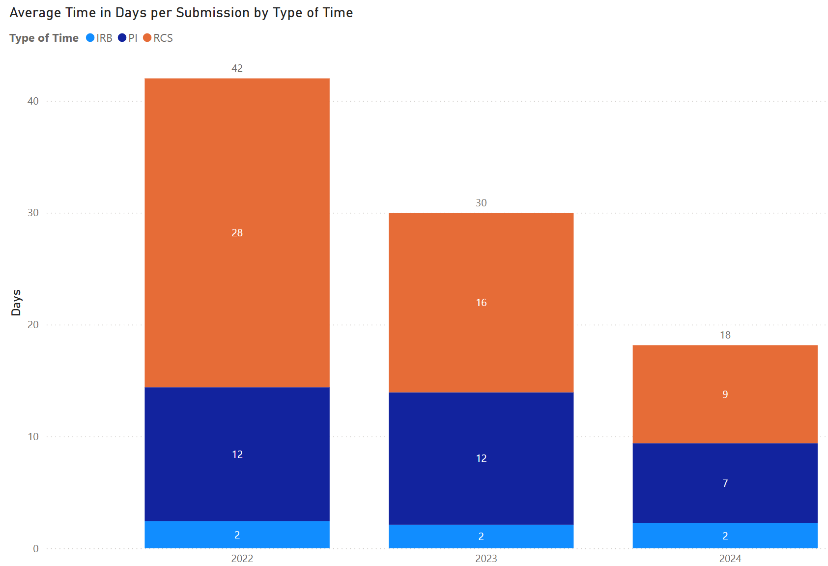
Metrics – turnaround times (all submissions)

Slide 10
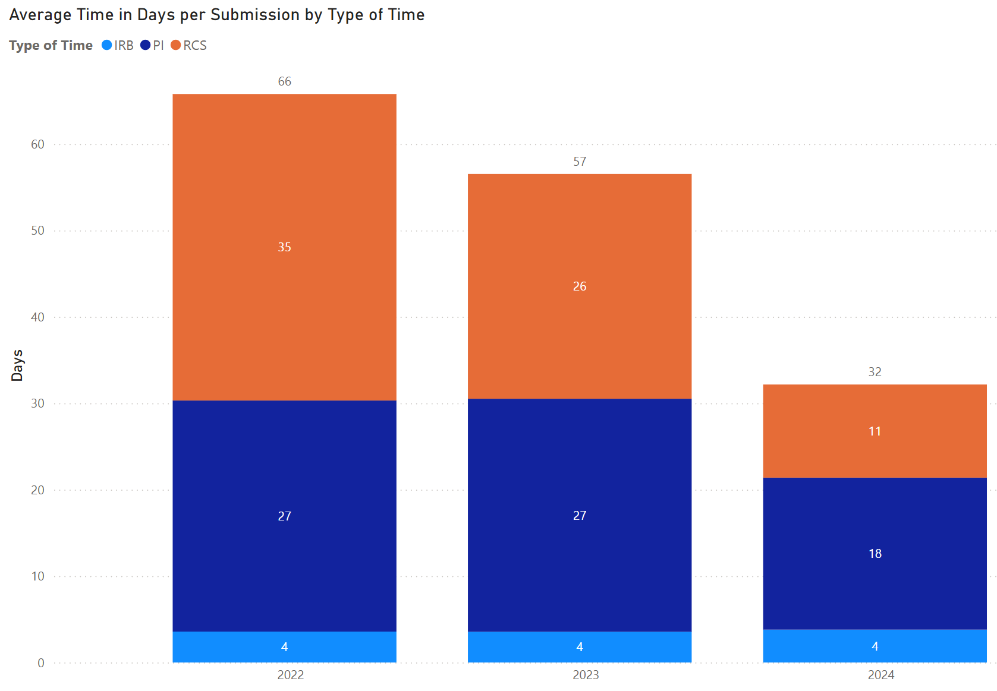
Metrics – turnaround times (new studies)
Notes:
Coming this summer (July 2025) – public facing dashboard of data

Slide 11
Questions and Answers
Can we get funding before IRB approval is granted?
Not if the funds are for human subject research activities
Possible option – Approval in Principle (AIP)
AIPs allow for projects that will eventually involve human subjects research but there are phases or other activities that need to be done first that don’t involve human subjects and the human subjects’ involvement will depend upon completion of instruments, prior animal studies, or purification of compounds etc.
NOT for situations where the researchers just haven’t completed their IRB materials
See UO AIP website: https://research.uoregon.edu/manage/research-integrity-compliance/human-subjects-research/aip

Slide 12
Questions and Answers
What funding information does the IRB need in the RAP?
Name of funding source
Funding and Sponsorship Form
Scope of work or grant narrative that describes the human subjects research activities
EPCS number(s)
Important: If a new EPCS number is given for the same funding, need to modify IRB submission to include new EPCS number
How does compliance information get updated in EPCS?
IRB staff update EPCS at time of approval (and is updated again if IRB approval period is extended)

Slide 13
Trouble Shooting Compliance Tab - EPCS
Top is often inaccurate,
look below

Slide 14
Trouble Shooting
Make sure study has been submitted in the RAP
Notes:
Only PI and PI proxy can submit

Slide 15
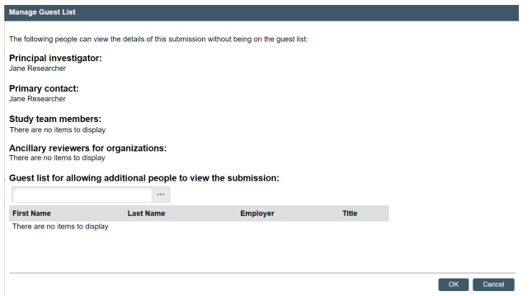
Trouble Shooting - Solutions
Researchers can give anyone at the UO view only access to their IRB submissions.
Done through “guest list”
See guidance here: https://research.uoregon.edu/sites/default/files/2023-09/rap_quick_reference_-_guest_list_0.pdf
Notes:
Optional – researchers can choose to do this or not

Slide 16
Where to look for updates?
Frontline Newsletter: https://research.uoregon.edu/forms/federal-updates#subscribefrontline
RCS Website: https://research.uoregon.edu/manage/integrity-compliance/human-subjects-research

Slide 17
Other Resources to Support Researchers
Contact us by phone, email and for individual appointments:
541-346-2510
researchcompliance@uoregon.edu
Available for remote individual and group consults – just call or email!
Weekly Remote Office Hours (no appointment needed – just click link)
Wednesdays 1:00–3:00 p.m.
Fridays 9:00–11:00 a.m.
Notes:
We’re here to help!

Slide 18
RCS Website Tools & Resources
OVPRI Main Site: https://research.uoregon.edu/
Human Subject Research Page: https://research.uoregon.edu/manage/research-integrity-compliance/human-subjects-research
Human Subject Research Forms Page: https://research.uoregon.edu/manage/research-integrity-compliance/human-subjects-research/human-subjects-applications-forms
HSR Guidance Library: https://research.uoregon.edu/manage/research-integrity-compliance/human-subjects-research/human-subjects-research-guidance-library
RAP Guidance Library Section: https://research.uoregon.edu/manage/research-integrity-compliance/human-subjects-research/human-subjects-research-guidance-library#RAP
On Demand Training website: https://research.uoregon.edu/plan/training-opportunities/human-subject-researchirb-trainings

Slide 19
Questions?

