Slide 1
Conflict of Interest, Conflict of Commitment, and Outside Activities Policy
(COI/COC Policy)
July 2024

Slide 2

Overview
COI/COC Policy
Common Activities Requiring Disclosure
How to Submit a Disclosure
Management Plan Process

Slide 3

What Is A Conflict of Interest?
Any action, decision, or recommendation by a person acting in their capacity as a UO employee that would (for actual conflicts) or could (for potential conflicts) have a private financial impact on the person or their relative or any business with which either is associated. ORS 244.020(1), (13)
This means employees are required to disclose activities for themselves, their spouse, and/or their relatives.
Oregon state ethics statute defines “relative” as:
  The spouse, parent, stepparent, child, sibling, stepsibling, son-in-law, or daughter-in-law of the public official
  The parent, stepparent, child, sibling, stepsibling, son-in-law, or daughter-in-law of the public official’s spouse
  Any individual for whom the public official has a legal support obligation
  Any individual for whom the public official receives benefits arising from the individual’s employment.

Slide 4
The COI/COC Policy
According to Oregon statute, the UO must authorize employees to receive outside compensation. (ORS 352.232)
COI/COC Policy provides a path to authorizing such activities while also complying with applicable state laws.
UO encourages employees to engage in outside activities that comport with the UO mission, including:
  Dissemination
  Translation and application of research
  Commercialization of research, scholarship, and creative activity
Policy applies to all UO employees, including those on courtesy appointments and visiting faculty.

Slide 5
Exempt Activities…
Unrelated to employee's UO job duties or not within field of expertise
Reimbursement for travel (remains subject to ORS 244.025 regarding gifts and ORS 244.042 regarding honoraria)
Appearances, performances, exhibits, or publications
Outside activities of student or graduate employees
Consulting as an individual or sole proprietor, unless…see next slide
Uncompensated activities
Employment that is not represented on the next slide

Slide 6
…Unless
(Disclosure and Approval Required)
Even if that activity occurs during sabbatical or other approved leave
Ownership of equity in an entity, including a consulting entity, that carries on activities closely related to the employee’s UO job duties and/or within field of expertise
Outside activities performed in exchange for equity in an entity, including a consulting entity, that carries on activities closely related to UO job duties and/or within field of expertise
Outside activities that involve research and development and/or the creation of technological improvements, inventions, or software
Managing or significant participation in the day-to-day operations of an entity that carries on activities closely related to the employee’s UO job duties and/or within field of expertise
Employment of UO students who the employee currently teaches, supervises, or advises or other UO employees who they supervise in the execution of outside activities

Slide 7
Regardless…
Regardless of whether an outside activity is exempt or requires approval, employees may not:
Make private, commercial use without permission of UO supplies, facilities, equipment, employees, records, intellectual property, or any other UO resources
Use non-public information accessed as a UO employee to obtain a private financial benefit
Engage in activities that substantially interfere with the employee’s duties to the UO (described on next slide)

Slide 8
Conflict of Commitment
For full-time, 9-month faculty, time commitments to outside activities cannot exceed one day in every seven-day week, generally averaged over a quarter. Prorated by FTE.
One-day-in-seven principle does not apply to summer months in which there is no UO FTE, during sabbatical or other approved leave, and UO holidays.
For hourly and part-time employees, outside activities performed outside of that employment are not considered a conflict of commitment

Slide 9

Common Examples of Outside Activities That Require Disclosure & Approval (1)
A research associate holds a courtesy appointment at another university to conduct research that will likely lead to a new process for removing metals from water, helping create clean water in countries that have limited access.
Why This Requires Disclosure:
Under the COI/COC Policy, research that becomes part of research and development or that could reasonably lead to technological improvements, inventions, or software must be disclosed and approved using a management plan.

Slide 10
Common Examples of Outside Activities That Require Disclosure & Approval (2)
As an independent consultant, a professor consults for a company to develop curricular supports in math for elementary students with limited English proficiency.
Why This Requires Disclosure:
Research and development doesn’t happen just in the hard sciences. Under the COI/COC Policy, research that becomes part of research and development or that could reasonably lead to technological improvements, inventions, or software must be disclosed and approved using a management plan.

Slide 11
Common Examples of Outside Activities That Require Disclosure & Approval (3)
An associate professor would like to hire a student she currently teaches to assist with a conference she is helping to organize for a professional association. The professor’s work with the professional association is part of her 20% service.
Why This Requires Disclosure:
The professor’s work with the professional association would be exempt under the COI/COC Policy since it is part of her service activities and thus not an outside activity. However, if the professor is going to hire the student through the professional association, employment of UO students who the employee currently teaches, directly supervises, or formally advises or employment of other UO employees the employee supervises in the execution of an outside activity requires disclosure and approval.

Slide 12
Common Examples of Outside Activities That Require Disclosure & Approval (4)
A research assistant, in coordination with colleagues from other institutions, is launching a new nonprofit. There is a lot of work to do! He often finds himself reviewing nonprofit formation documents, responding to emails about the nonprofit, or drafting content for a new website in between meetings.
Why This Requires Disclosure:
This outside activity would rise to the level of managing or significantly participating in the day-to-day operations of an entity that carries on activity closely related to the employee’s UO job duties and/or within their field of expertise. Under the COI/COC Policy, disclosure and approval via a management plan is required.
In addition, there may be a conflict of commitment if the outside activity is interfering with his UO job duties. This analysis does not change just because he is not receiving payment nor because the outside entity is a nonprofit. The research assistant may also be using a UO laptop for the outside activity, and use of public resources in an outside activity is prohibited.

Slide 13
Common Examples of Outside Activities That Require Disclosure & Approval (5)
An associate professor and a postdoctoral scholar working in his lab have identified a novel drug delivery system. After working with Industry, Innovation, and Translation, they cannot identify an existing company who might be a good fit to license the technology. They decide to launch their own company to bring the technology to market.
Why This Requires Disclosure:
Equity ownership in an entity that carries on activities closely related to an employee’s job duties and/or within their field of expertise requires disclosure and approval via a management plan. Additional consideration must be made to ensure that public resources, such as lab space, laptops, or the time of graduate students working in the UO lab, are not used to benefit the spin-out company. Clear boundaries must also be made to protect the UO’s intellectual property and determine ownership of potential revisions or derivative works.

Slide 14
Common Examples of Outside Activities That Require Disclosure & Approval (6)
Remember: If you also receive sponsored research funding, you are subject to the UO’s Financial Conflict of Interest in Research Policy (FCOI Policy).
You may be required to disclose outside activities and interests under the FCOI Policy. Learn more about what must be disclosed under the FCOI Policy.
Unsure if your outside activity requires disclosure and approval?
Ask us!
coi@uoregon.edu

Slide 15

How to Disclose an Outside Activity (1)
Disclosures must be made before the outside activity begins and annually updated if the employee has an outside activity resulting in a management plan.
Disclosures are submitted through the Research Administration Portal (RAP) at coi.rap.uoregon.edu. You will be prompted to enter your Duck ID.

Slide 16
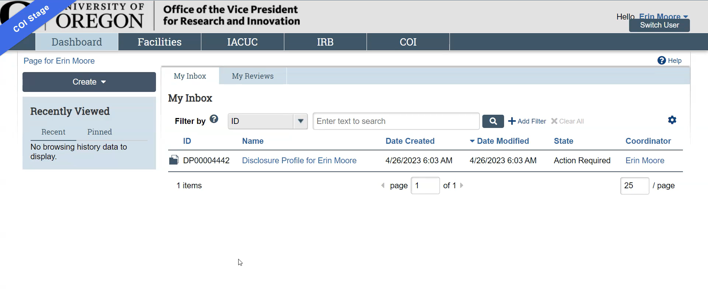
How to Disclose an Outside Activity (2)

Slide 17
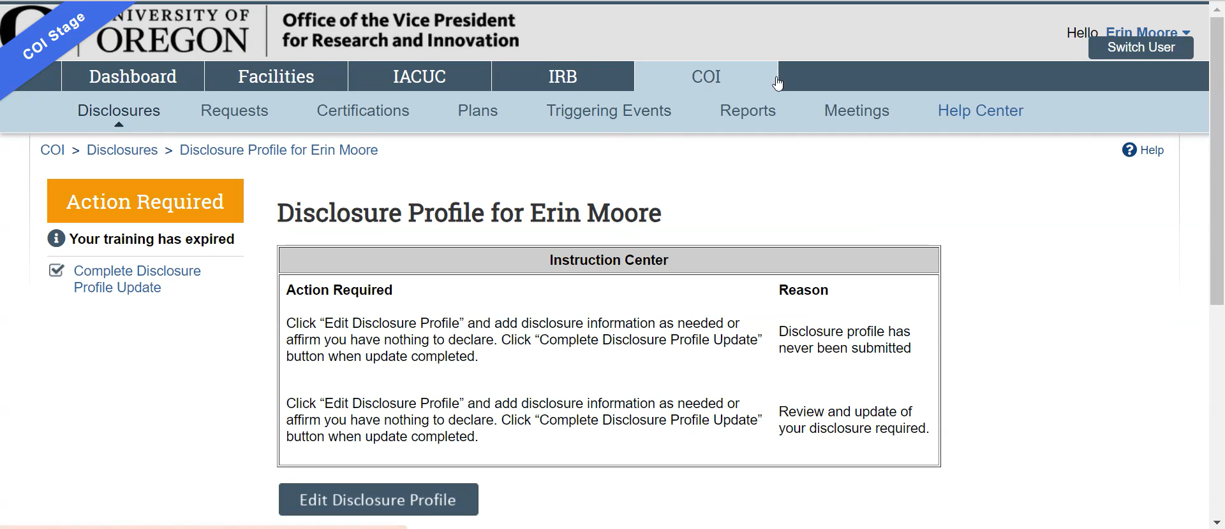
How to Disclose an Outside Activity (3)

Slide 18
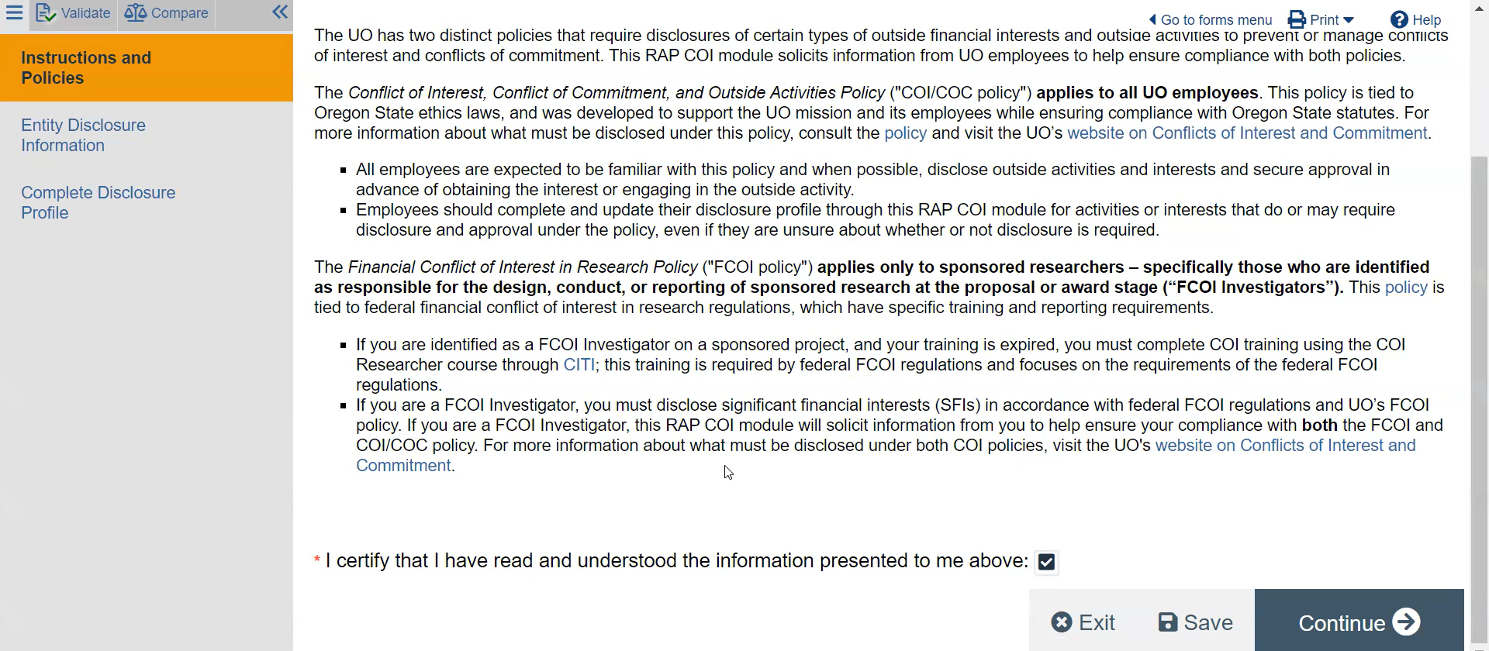
How to Disclose an Outside Activity (4)

Slide 19
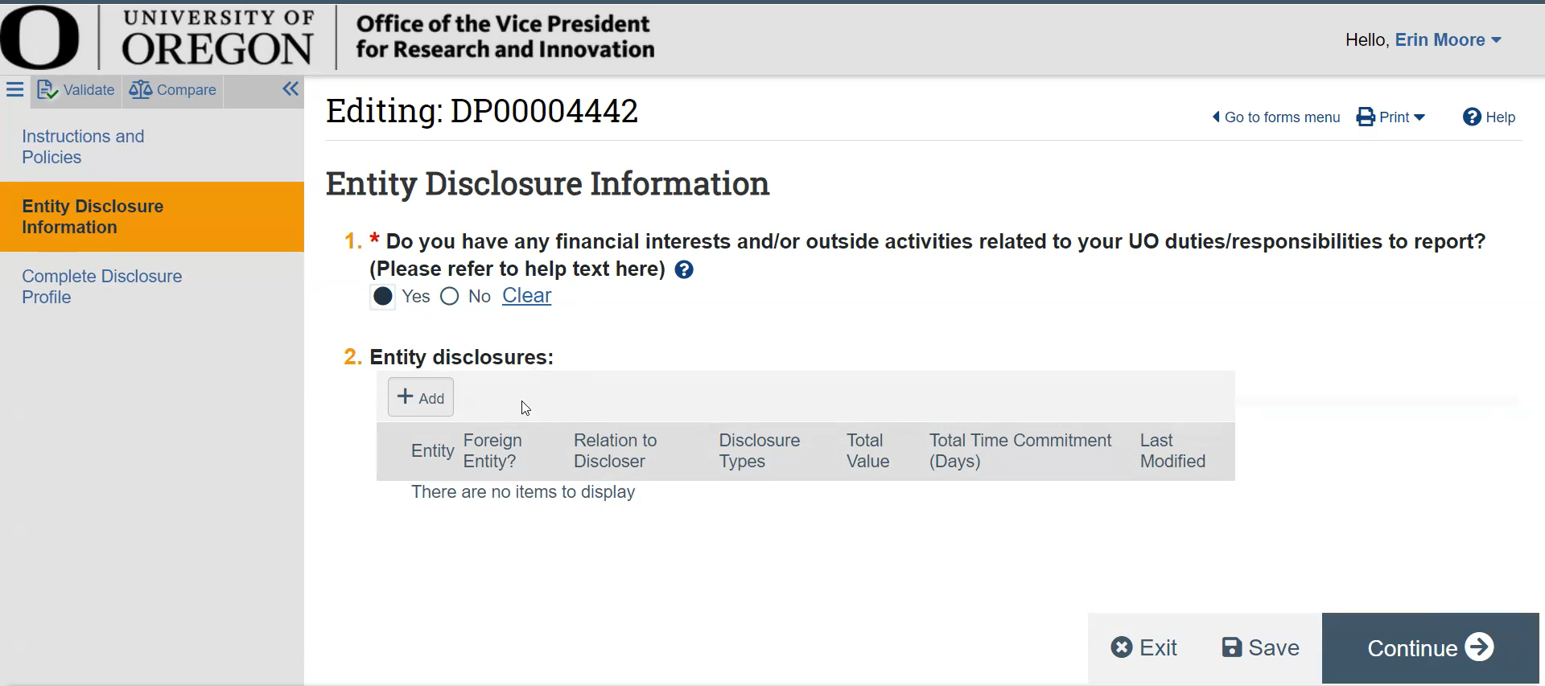
How to Disclose an Outside Activity (5)

Slide 20
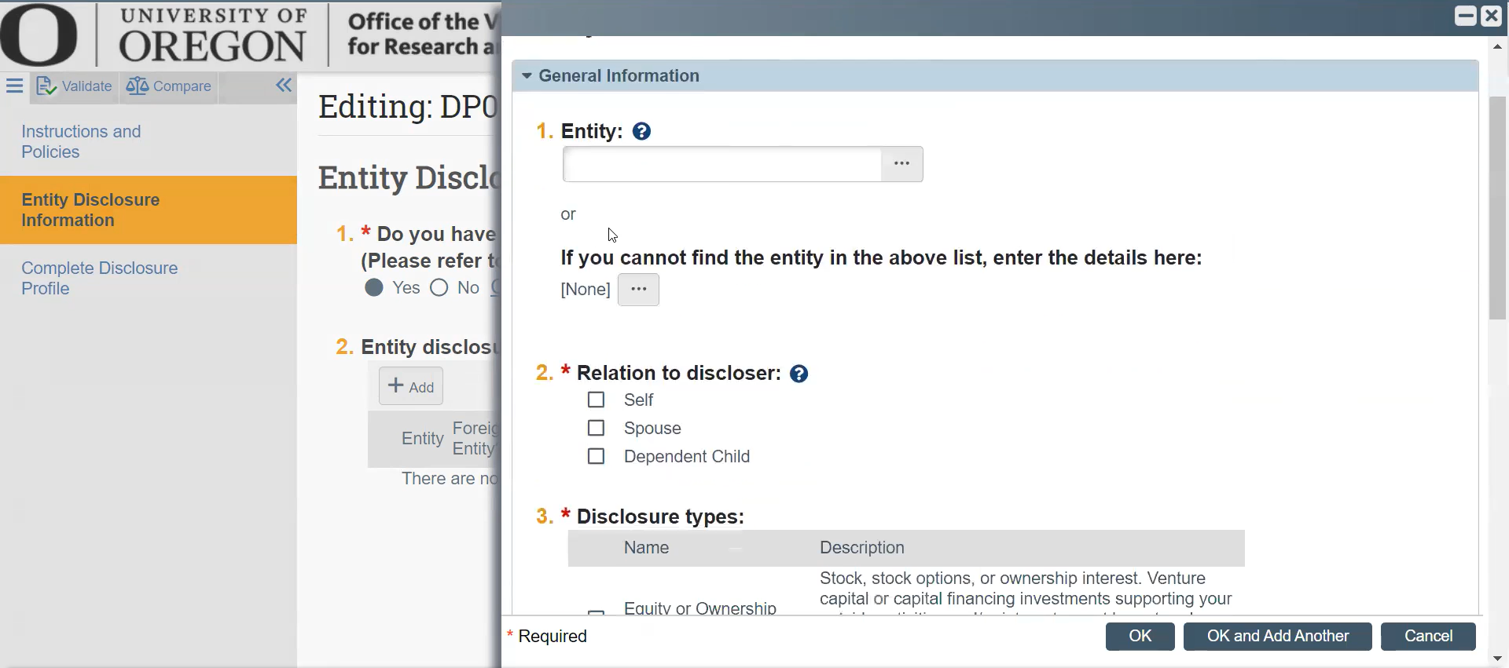
How to Disclose an Outside Activity (6)

Slide 21
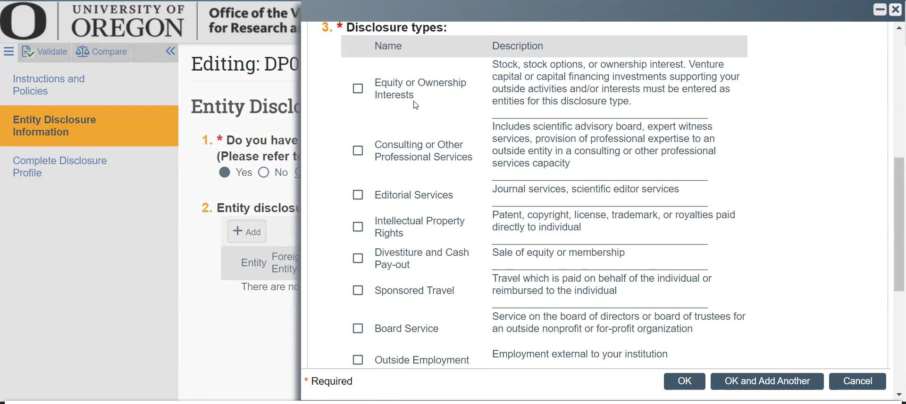
How to Disclose an Outside Activity (7)

Slide 22
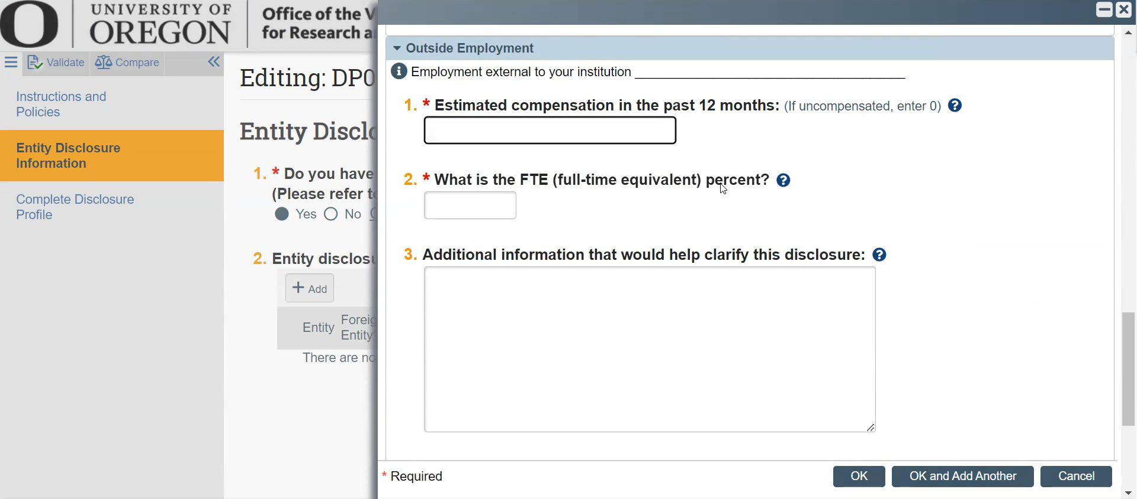
How to Disclose an Outside Activity (8)

Slide 23
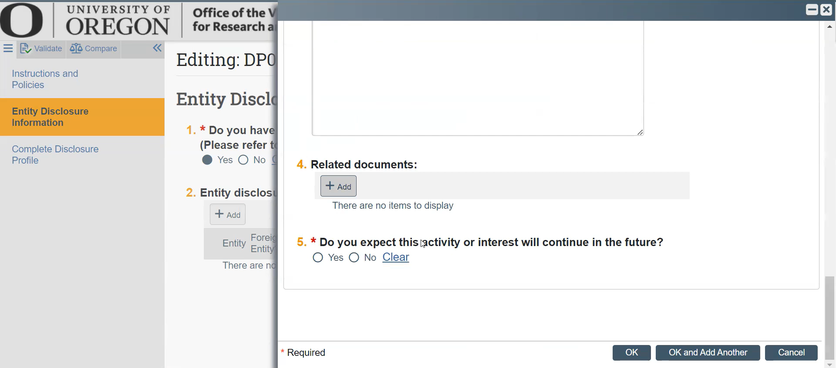
How to Disclose an Outside Activity (9)

Slide 24
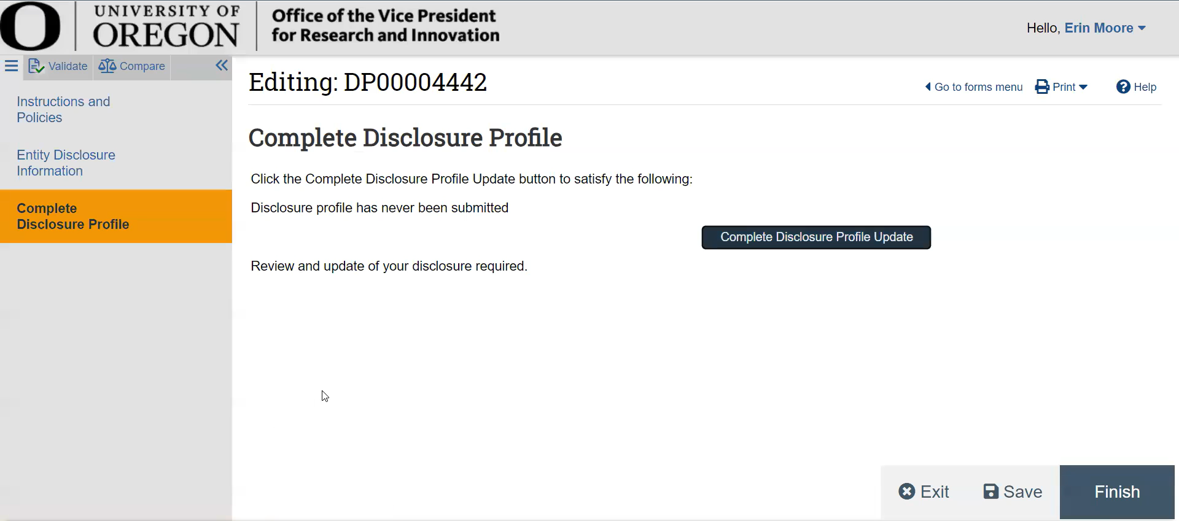
How to Disclose an Outside Activity (10)

Slide 25
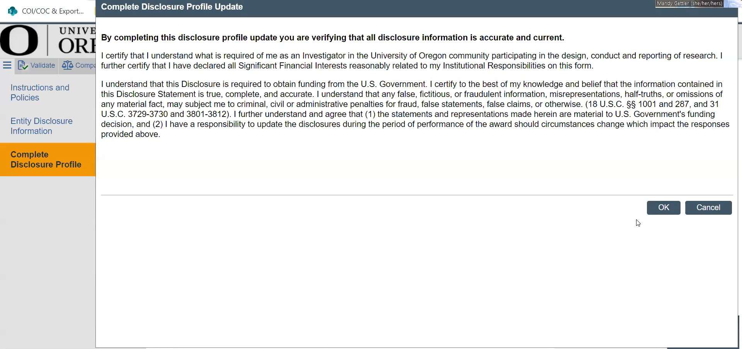
How to Disclose an Outside Activity (11)

Slide 26
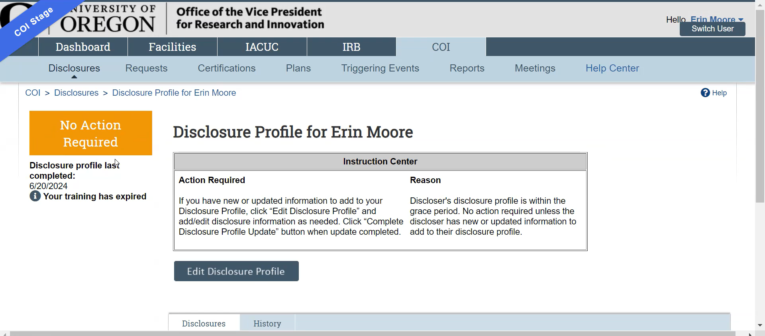
How to Disclose an Outside Activity (12)

Slide 27

What Happens With Your Disclosure
Conflict of Interest Office reviews disclosures within 3 business days. Management plan drafts are ready within 1-2 weeks.
If no conflict is identified, employee will not hear from our office.
If a conflict is identified, employee will receive an email with next steps: the management plan.
Disclosures in which a conflict is identified are subject to public records requests. Some responses to disclosure questions request amounts of compensation. It is OK to provide a range estimate. The compensation does not affect a COI/COC determination, but may be required under the Financial Conflict of Interest in Research Policy, which applies to all researchers receiving sponsored awards.

Slide 28
Management Plan Process (1)
COI Office drafts plan.
Signatories provide electronic approval in the RAP.
Employee accepts plan in the RAP.
IIT approves IP section.
Employee reviews plan and provides feedback.
Signatories review plan and provide feedback.
Employee may begin outside activity

Slide 29
Management Plan Process (2)
Depending on how quickly COI Office hears back from employee and signatories, process from start to finish can take as little as two weeks or as many as six.
Employee can always view track changes and comments in the Sharepoint document.
Management plans are subject to public records requests.

Slide 30
Links
COI/COC Policy
Research Administration Portal (RAP)
You will be prompted to enter your Duck ID.
FAQs
COI Office website

Slide 31
Definitions
Conflict of commitment: A situation where an individual engages in outside activities, either paid or unpaid, that substantially interfere with the individual’s duties to the University of Oregon.
Conflict of interest: Any action, decision, or recommendation by a person acting in their capacity as a University employee that would (for actual conflicts) or could (for potential conflicts) have a private financial impact on the person or their relative, or any business with which either is associated. ORS 244.020(1), (13)
Consulting: Providing expert knowledge or advice to an entity or person. It does not include conducting research and development or the creation of technological improvements, inventions, or software.
Consulting entity: Any business, company, or other organization, including (but not limited to) any partnership, corporation, limited liability corporation, or other institution whether public, for-profit, or not-for-profit that provides expert knowledge or advice to an entity or person.
Employee: Any employee, official, or agent as defined by state law.
Entity: Any business, company, or other organization, including (but not limited to) any partnership, corporation, limited liability corporation, foreign government or agent, or other institution whether public, for-profit, or not-for-profit.
Duties: Responsibilities expected and performed on behalf of the University for which people are employed by the University, as described in a position description, unit-level workload policy, assigned by a supervisor, or otherwise required of an employee by the University.
Outside activities: Things that an employee does which are not duties and are not performed on behalf of the University

Slide 32

Contact Information
COI Office
coi@uoregon.edu
Our Website

