Slide 1
Financial Conflict of Interest in Research Policy
(FCOI Policy)
July 2024

Slide 2

Overview
Overview
FCOI Policy
Common Activities Requiring Disclosure
How to Submit a Disclosure
Management Plan Process

Slide 3

What Is A Financial Conflict of Interest in Research?
Significant Financial Interest that could directly and significantly affect the design, conduct, or reporting of research, as determined by the university.
SFI further defined on next slide.
The Financial Conflict of Interest in Research (FCOI) Policy applies to:
  Project director or principal investigator (PI)
  Any other person, regardless of title or position, who is responsible for the design, conduct, or reporting of Sponsored Research
  Can include but is not limited to professorial faculty, research associates, emeritus faculty, research collaborators, post-doctoral students, graduate students, visiting scientists, and individuals with courtesy appointments, external collaborators, or outside consultants, regardless of whether paid or unpaid.
Researchers are required to disclose activities for themselves, their spouse, and/or their dependent children annually, within 30 days of acquiring a new activity or interest, and within 30 days of a change in an existing activity or interest.
Researchers must complete Financial Conflict of Interest in Research training every 3 years.
Researchers submit disclosures in the Research Administration Portal (RAP).

Slide 4
Significant Financial Interest (SFI)
A financial interest consisting of one or more of the following interests of the researcher (and those of the researcher’s spouse and dependent children) that reasonably appears to be related to the researcher’s institutional responsibilities:
$5,000 in remuneration from a publicly traded entity in the 12 months preceding disclosure and the value of any equity interest. Remuneration can include salary, consulting fees, honoraria, paid authorship. Equity interest includes any stock, stock option, or ownership interest.
$5,000 in remuneration from a non-publicly traded entity in the 12 months preceding disclosure and the value of any equity interest. Remuneration can include salary, consulting fees, honoraria, paid authorship. Equity interest includes any stock, stock option, or ownership interest.
Any intellectual property rights and interests (e.g., patents, copyrights), upon receipt of income related to such rights and interests.
Reimbursed or sponsored travel that is paid on behalf of and not reimbursed to the investigator that exceeds $5,000 per individual entity when aggregated and that is related to the investigator’s institutional responsibilities.

Slide 5
A Significant Financial Interest (SFI)
Is Not…
Significant Financial Interest does not include:
Salary, royalties, or other remuneration paid by the UO, including intellectual property rights assigned to the UO
Income from investment vehicles, such as mutual funds and retirement accounts, as long as the investigator does not directly control the investment decisions made in these vehicles
Payment from a federal, state, or local government agency; an institution of higher education as defined at 20 U.S.C. 1001(a); an academic teaching hospital; a medical center; or a research institute affiliated with an institution of higher education for:
  Seminars, lectures, or teaching engagements
  Service on advisory committees or review panels

Slide 6
FCOI Policy
A Significant Financial Interest does not necessarily mean there is a financial conflict of interest with the sponsored research.

Slide 7
Required Training
The FCOI Policy and federal funding agencies require all researchers responsible for the design, conduct, and reporting of sponsored research to complete financial conflict of interest training.
Training is good for 3 years.
UO uses the Collaborative Institutional Training Initiative (CITI) to deliver the training. The course is called COI Researcher. Learn more about the required training, such as adding the COI Researcher course and affiliating your CITI account with the UO.
Training completion dates migrate from CITI to the Research Administration Portal (RAP) each night.
Completed training required before RAP will allow researcher to submit disclosure.

Slide 8
Congruence with Documents Submitted to Sponsors
UO required to annually disclose researchers' external commitments to funding agencies.
UO required to notify funding agency within 30 days of any disclosure failure.
In current/pending support documents, biosketches, and Digital Persistent Identifiers (DPIs), PIs must disclose:
  Organizational affiliations and employment
  External positions and appointments
  Foreign government-sponsored talent recruitment programs (prohibited from being party to malign foreign talent recruitment program)
  Honorary titles, degrees, and lab space at other institutions, especially if foreign
  Even if there is no monetary value
Disclosures must match what is reported annually to Conflict of Interest Office via Research Administration Portal
  What’s often missed: Honorific titles, unpaid appointments, unpaid board service, outside activities generating <$5,000/year since they may not be subject to UO’s FCOI Policy
When in doubt, disclose, disclose, disclose!

Slide 9

Common Examples of Outside Activities That Require Disclosure (1)
A research associate holds a courtesy appointment at another university to access lab space and advise students.
Why This Requires Disclosure:
Because the researcher has access to lab space, it should be disclosed to the sponsor in a biosketch, current/pending support document, and Digital Persistent Identifier.
Although the researcher may not be receiving monetary funds, they should report the appointment to the UO via the RAP. The appointment may not be subject to the UO’s FCOI Policy, but disclosures across institutions must match.

Slide 10
Common Examples of Outside Activities That Require Disclosure (2)
As an independent consultant, a researcher consults for a company to develop curricular supports in math for elementary students with limited English proficiency. The researcher received $6,500 last year for their work.
Why This Requires Disclosure:
Under the FCOI Policy, remuneration of more than $5,000 in the previous 12 months from a non-publicly traded or publicly traded entity is considered a Significant Financial Interest and must be disclosed.

Slide 11
Common Examples of Outside Activities That Require Disclosure (3)
A research assistant is listed as a patent inventor on a patent held by the University of California Berkely, their previous institution. They receive quarterly royalties from the licensing of the patent.
Why This Requires Disclosure:
Intellectual property rights and interests of any value are a Significant Financial Interest upon receipt of the income.
If UC-Berkely were paying the researcher for a seminar, lecture, teaching engagement, or service on review panels or advisory committee, this would not be a SFI and would not need to be disclosed.

Slide 12
Common Examples of Outside Activities That Require Disclosure (4)
Remember: As a UO employee, you are also subject to the UO’s Conflict of Interest, Conflict of Commitment, and Outside Activities Policy (COI/COC Policy).
You may be required to disclose outside activities and interests under the COI/COC Policy. Learn more about what must be disclosed under the COI/COC Policy.
Unsure if your outside activity requires disclosure?
Ask us!
coi@uoregon.edu

Slide 13

How to Disclose an Outside Activity (1)
Disclosures must be submitted annually, even if a researcher has nothing to disclose; within 30 days of a change in an outside activity or interest; and within 30 days of acquiring a new outside activity or interest.
Disclosures are submitted through the Research Administration Portal (RAP) at coi.rap.uoregon.edu. You will be prompted to enter your Duck ID.

Slide 14
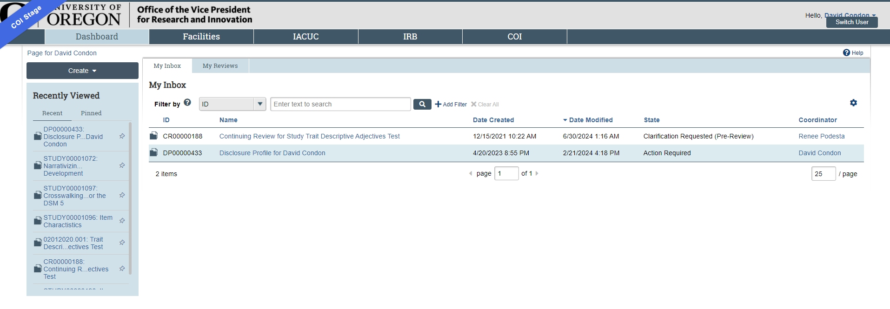
How to Disclose an Outside Activity (2)

Slide 15
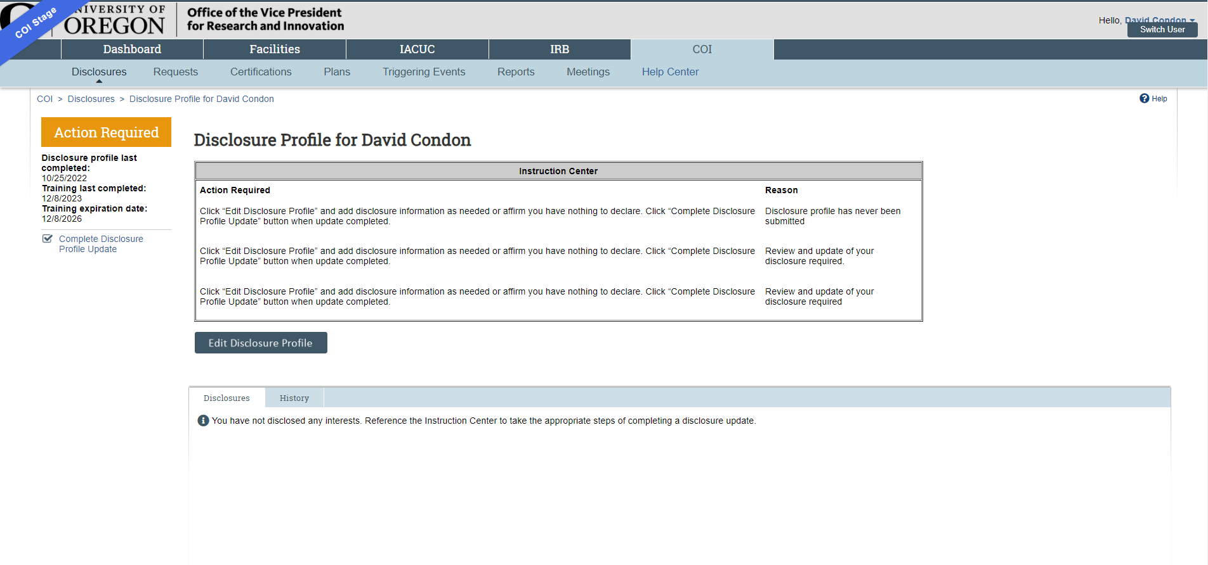
How to Disclose an Outside Activity (3)
Note: Training Must Be Current

Slide 16
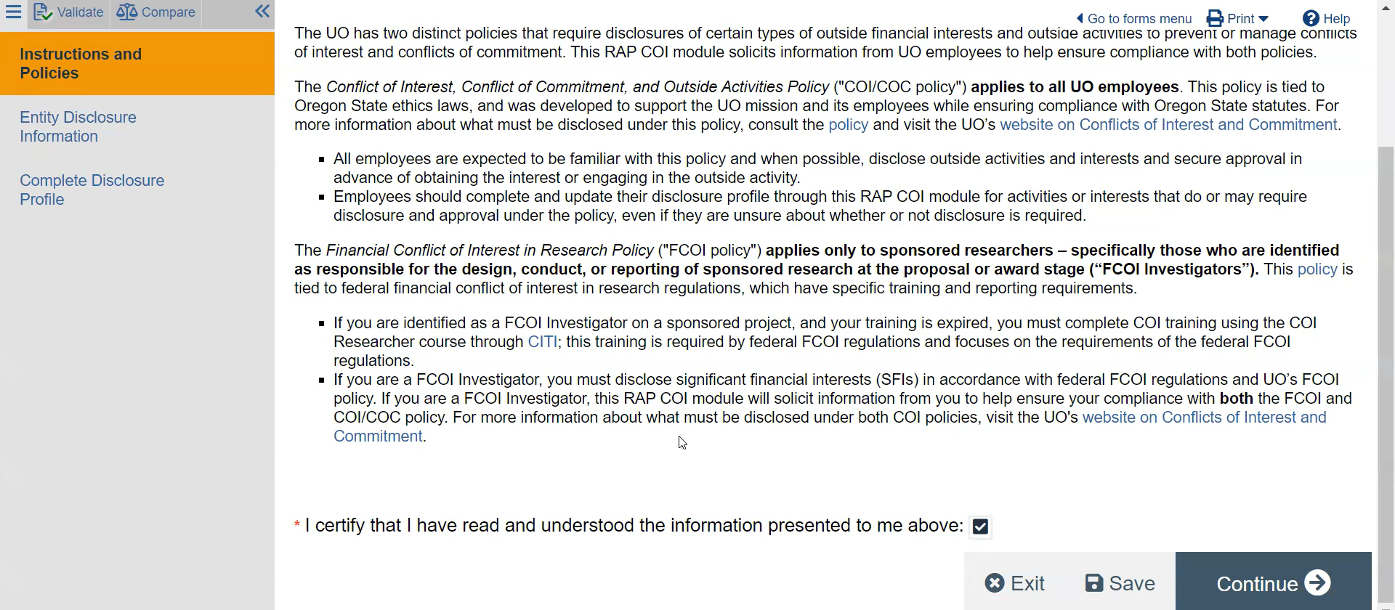
How to Disclose an Outside Activity (4)

Slide 17
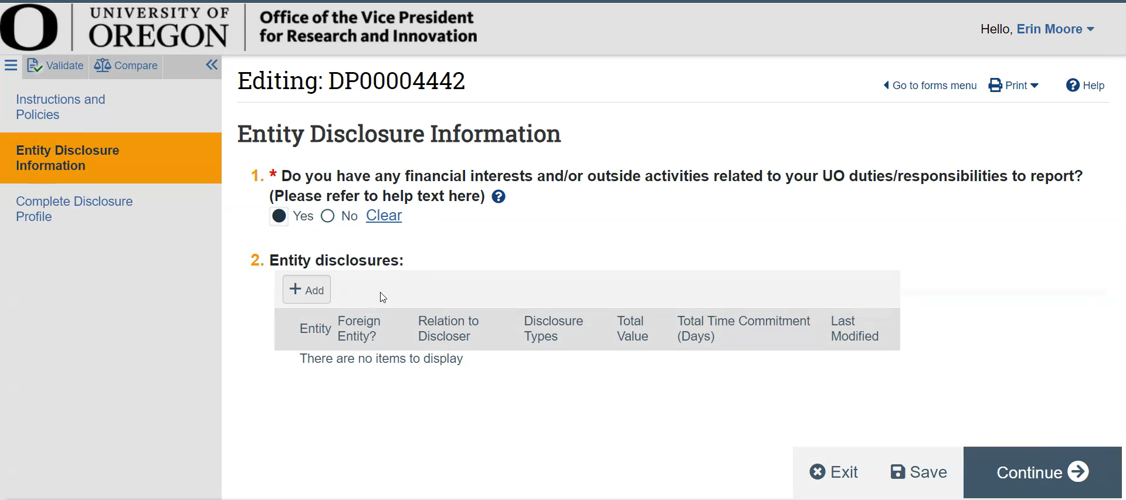
How to Disclose an Outside Activity (5)

Slide 18
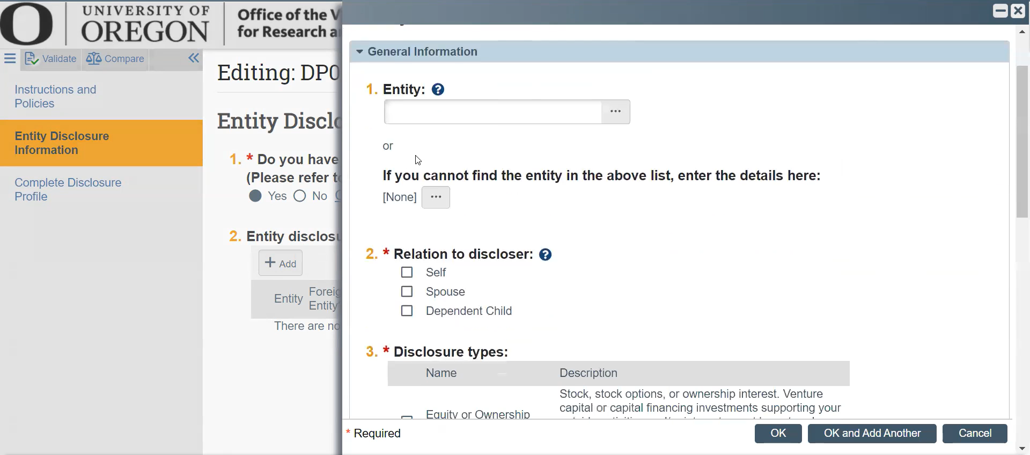
How to Disclose an Outside Activity (6)

Slide 19
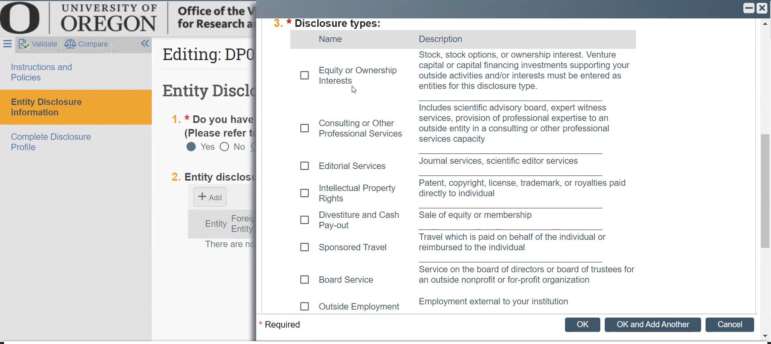
How to Disclose an Outside Activity (7)

Slide 20
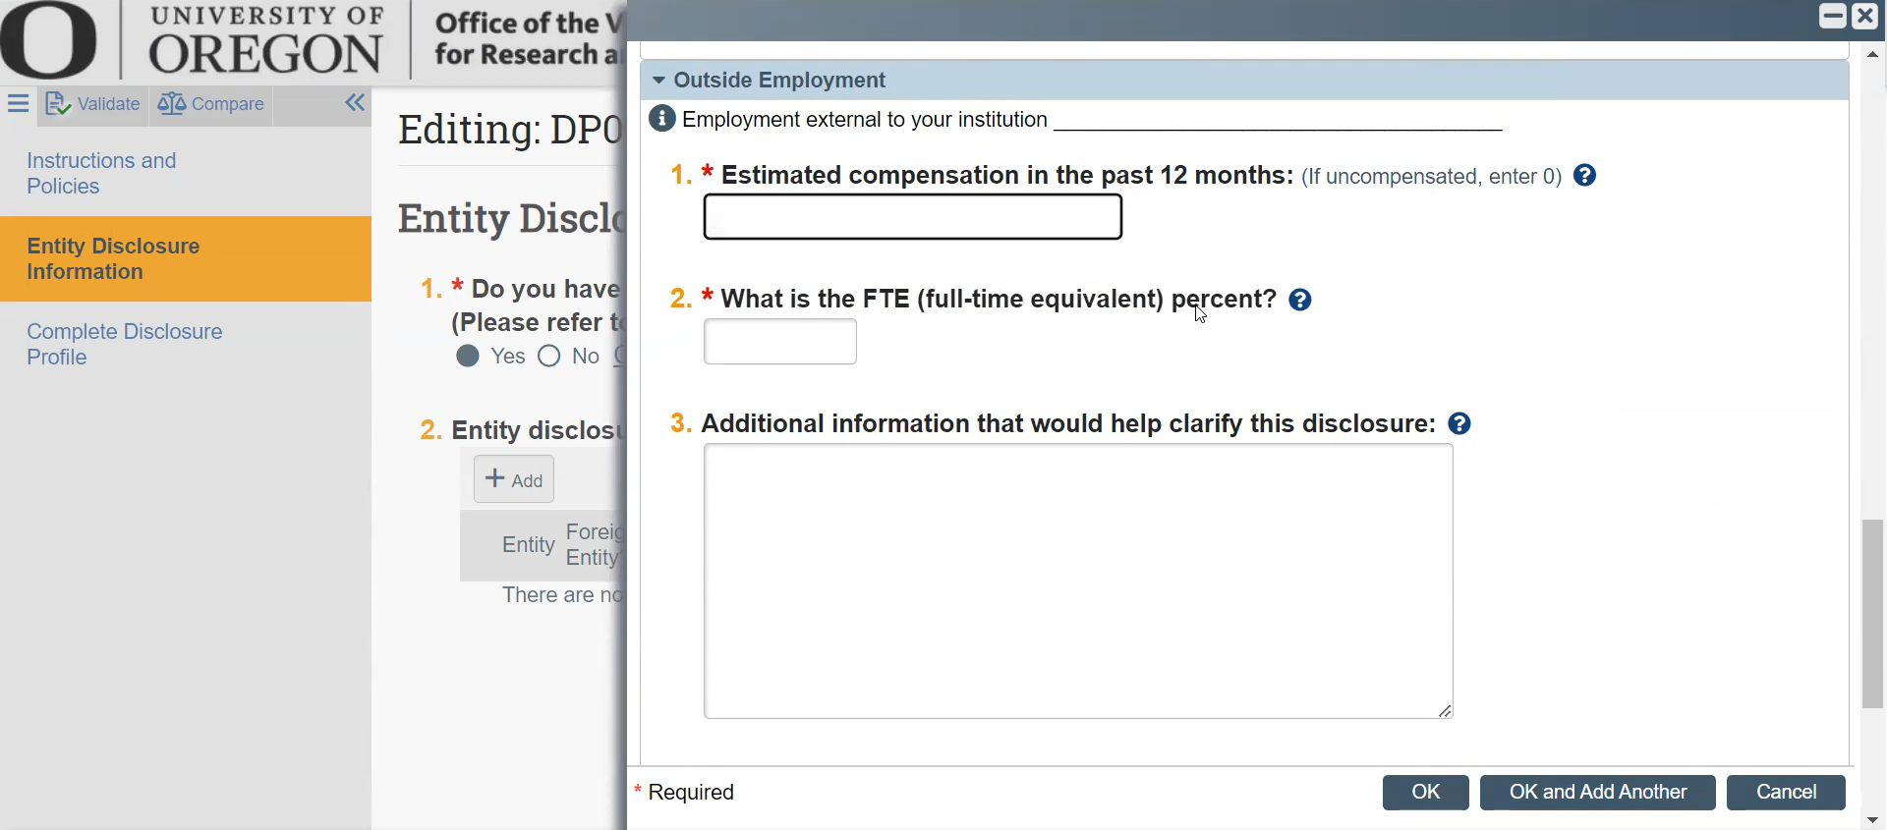
How to Disclose an Outside Activity (8)

Slide 21
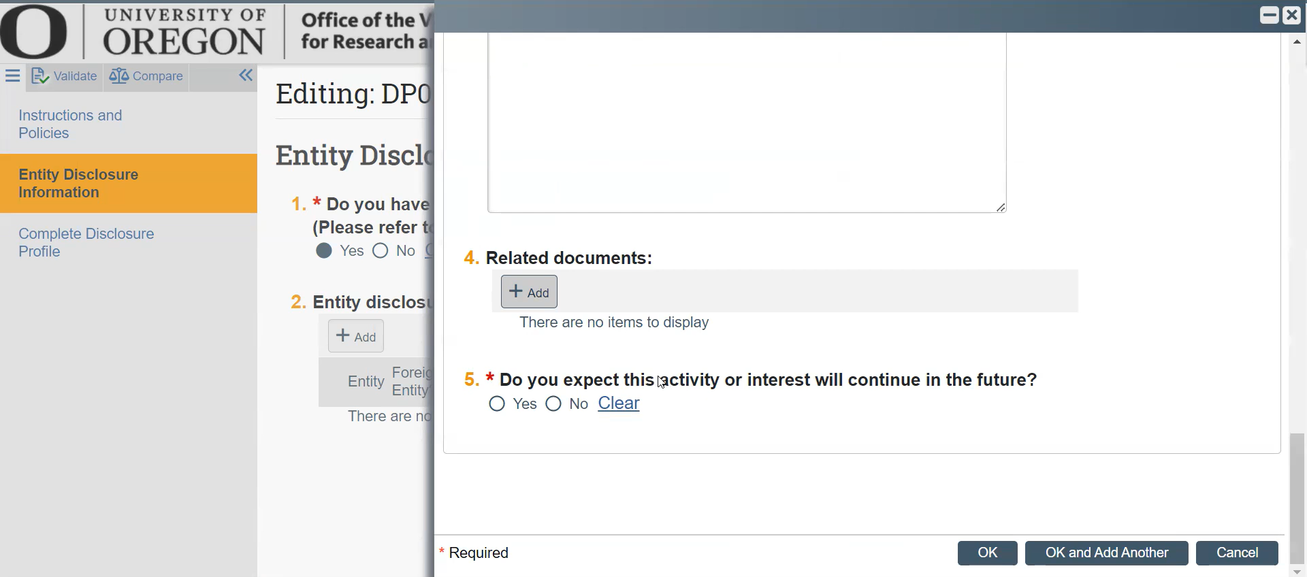
How to Disclose an Outside Activity (9)

Slide 22
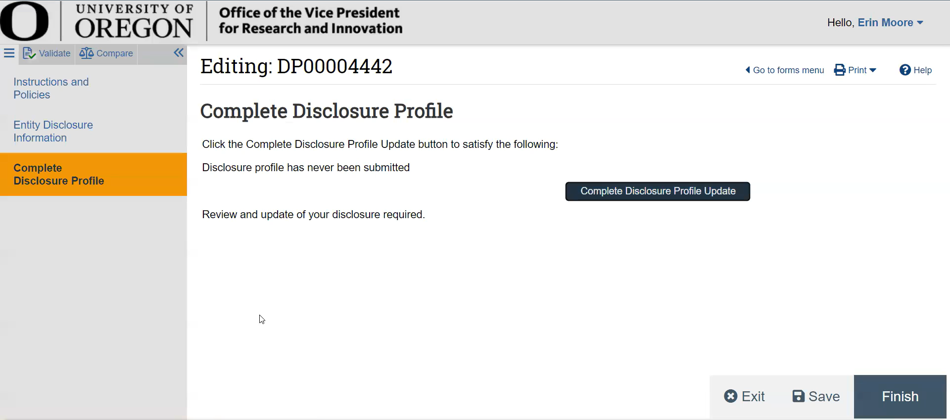
How to Disclose an Outside Activity (10)

Slide 23
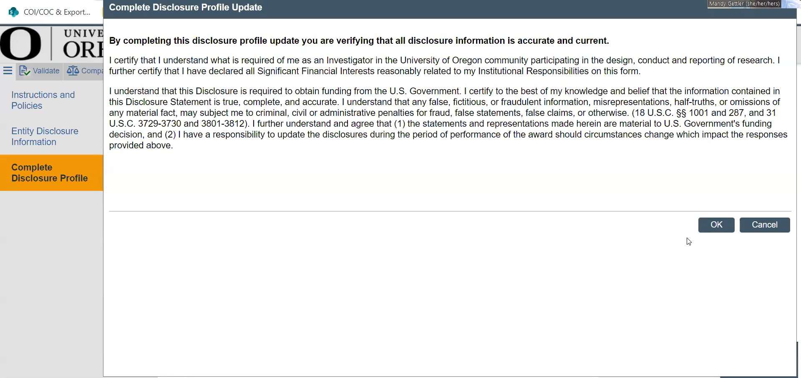
How to Disclose an Outside Activity (11)

Slide 24
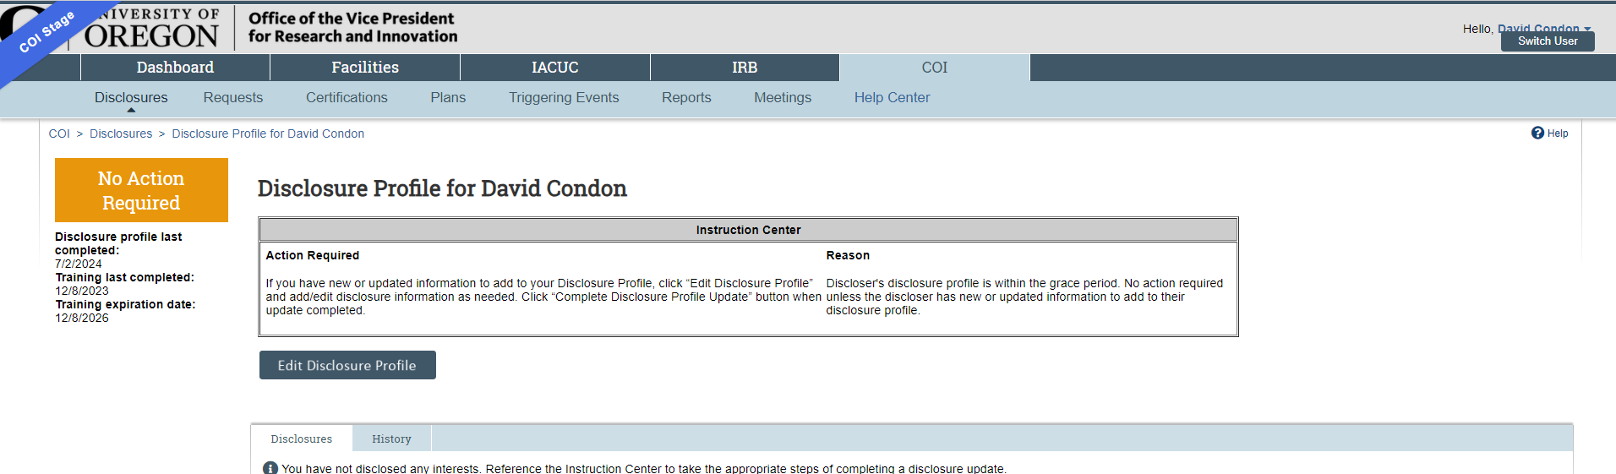
How to Disclose an Outside Activity (12)

Slide 25
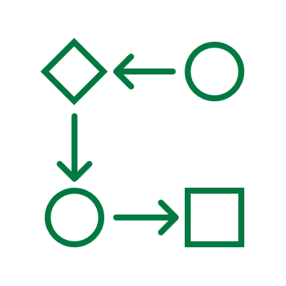
What Happens With Your Disclosure
Conflict of Interest Office reviews disclosures within 3 business days. Disclosures are compared against documents in EPCS to determine whether a researcher’s SFI presents a financial conflict of interest.
If no conflict is identified, researcher will not hear from our office. COI Office notifies Sponsored Project Services that award action can proceed.
If a conflict is identified, researcher will receive an email with next steps: the management plan.
Disclosures in which a conflict is identified are subject to public records requests. Some responses to disclosure questions request amounts of compensation. It is OK to provide a range estimate.

Slide 26
Management Plan Process (1)
COI Office drafts plan.
Signatories provide electronic approval in the RAP.
Employee accepts plan in the RAP.
IIT approves IP section.
Conflict of Interest in Research Committee approves steps.
Researcher and signatories review plan.
Sponsor notified. Award action processed.

Slide 27
Management Plan Process (2)
Conflict of Interest in Research Committee (COIRC) oversees management plan process and recommends plan steps to mitigate financial conflict of interest with the sponsored research.
Employee can always view track changes and comments in the Sharepoint document.
Management plans are subject to public records requests. Steps in a management plan must be shared with the sponsor.

Slide 28
Links
FCOI Policy
Research Administration Portal (RAP)
You will be prompted to enter your Duck ID.
FAQs
COI Office website

Slide 29
Definitions
Conflict of Interest in Research means a Significant Financial Interest that could directly and significantly affect the design, conduct, or reporting of Research, as determined by the university.
Declaration means an Investigator’s formal or explicit statement disclosing Significant Financial Interests to the university.
Financial Interest means anything of monetary value, whether or not the value is readily ascertainable.
Investigator means the project director or principal Investigator, and any other person, regardless of title or position, who is responsible for the design, conduct, or reporting of Sponsored Research. Investigator can include but is not limited to: professorial faculty, research associates, emeritus faculty, research collaborators, post-doctoral students, graduate students, visiting scientists, and individuals with courtesy appointments, external collaborators, or outside consultants, regardless of whether paid or unpaid. The term Investigator does not usually apply to, but does not preclude, departmental grant administrators or financial staff.
Institutional responsibilities means an Investigator's professional responsibilities on behalf of the Institution, and as defined by the Institution in its policy on financial conflicts of interest, which may include for example: activities such as research, research consultation, teaching, professional practice, institutional committee memberships, and service on panels such as Institutional Review Boards or Data and Safety Monitoring Boards.
Management Plan means the prospective plan for COIR mitigation.
Mitigation Report means a retrospective report for COIR mitigation compliant with Sponsor’s requirements.
NIH Standards means the U.S. Department of Health and Human Services (DHHS) regulations on Promoting Objectivity in Research (42 CFR Part 50, Subpart F) and Responsible Prospective Contractors (45 CFR Part 94).
Research means a systematic investigation, study or experiment designed to develop or contribute to generalizable knowledge. The term encompasses basic and applied research (e.g., a published article, book or book chapter) and product development (e.g., a diagnostic test or drug). It includes any activity for which research funding is awarded through grant, award, fellowship, training, project, or research resources award.

Slide 30

Contact Information
COI Office
coi@uoregon.edu
Our Website

