Slide 1
NIH Virtual Seminar November 1- 4, 2021 Understanding NIH Career Development “K” Awards
Dennis A. Twombly, Ph.D. Ryan Talesnik Deputy Director, Office of Extramural Policy Senior Grants Management Specialist Training Director, NICHD-NIH Grants Management Branch, NICHD-NIH

Slide 2
What are Career Development “K” awards?
Purpose: Awards to provide scholars with protected time to conduct research and career development activities leading to independence in the biomedical, behavioral, or clinical sciences.
Types of Awards: There are multiple “K” Award types designed for different scientific/educational backgrounds and career stages.
Mentored – For early-stage investigators needing mentored research training
Non-mentored – For independent investigators to acquire new research skills or to support mentoring activities
Institutional – Awards to institutions to support multiple K-level scholars

Slide 3
Research Training and Career Development
Fellowships & Career Awards
GRADUATE &
MEDICAL
STUDENTS
T32 Institutional Training Grants (Predoctoral slots)
F30 Pre-doctoral Fellowships (MD/PhD Programs)
F31 Pre-doctoral Fellowships (Parent F31)
F31 Diversity Pre-doctoral Fellowships
Training
POST-
DOCTORAL
FELLOWS
T32 Institutional Training Grant (Post-doctoral slots)
F32 Individual Post-doctoral Fellowships
Research Grants
K22 Career Transition Award (some ICs)
K99-R00 Pathway to Independence Award
Transition
R03 Small Grant
K12 Institutional Career Development Award
R21 Exploratory-
Developmental
Grant
K01 Mentored Research Scientist Development Award
K08 Mentored Clinical Scientist Development Award
K23 Mentored Patient-Oriented K Award
K25 Mentored Quantitative K Award
FACULTY
R01 Research Project Grant
Independent
K02 Independent Scientist Award
K24 Mid-career Award in Patient-Oriented Research
Notes:
This schematic shows where K awards fit in the progression of training and career development.

Slide 4
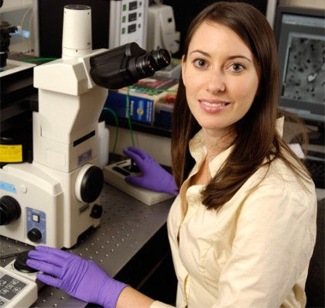
Mentored K award programs
K01 Mentored Research Scientist Development Award (usually PhDs)
K07 Academic Career Development Award
K08 Mentored Clinical Scientist Development Award (clinical degrees)
K18 Research Career Enhancement Award for Established Investigators
K22 Research Career Award for Transition to Independence (not NICHD)
K23 Mentored Patient-Oriented Research Development Award (clinical degrees)
K25 Mentored Quantitative Research Development Award
K43 Emerging Global Leader Award
K99/R00 NIH Pathway to Independence Award
Notes:
Most K awards simply require a doctoral degree of some kind. Typical applicants are senior postdoctoral fellows through junior faculty. Some ICs limit the number of years of experience beyond the end of clinical training.
The K08 and K23 require a clinical degree such as MD, MD/PhD, DDS, PharmD, or other clinical doctoral degree (eg, clinical psychology, physical therapy, nursing). Other degree types are listed in the FOA. PhDs in a clinical discipline such as Clinical Psychology are also eligible.
Those with clinical degrees are eligible for the K99, provided they fulfill other eligibility requirements.
Many applicants may be eligible for multiple Ks. Clinical scholars may be eligible for K01, K08, K23, and K99. Talk to Scientific/Research contact for guidance.
Several ICs have a limit of 6 - 8 years aggregate support through K12 + Individual K

Slide 5
NIH Organization
Different NIH institutes have different K programs and requirements
NHLBI
OD
NIBIB
NIEHS
NIAMS
NCI
NIMHD
NIDA
NIMH
NINR
NEI
NLM
NIDDK
NIGMS
NINDS
NHGRI
NIDCR
NCCIH
NIA
NIDCD
CIT
NIAAA
NICHD
CSR
NIAID
FIC
Clin Ctr
NCATS
Notes:
Different NIH Institutes (ICs) use K programs differently and have different requirements for salary, eligibility, scientific topic area, etc.
Any K application must be on a topic related to the sponsoring IC’s mission.

Slide 6
Refer to Program Announcements (PAs) !!
Funding Opportunity Title
NIH Pathway to Independence Award (Parent K99/R00 - Independent Clinical Trial Not Allowed)
Funding Opportunity Announcement (FOA) Number
PA-18-398 (Clin Trial not allowed); PA-18-397 (Clin Trial Req’d)
Components of Participating Organizations (all NIH ICs, e.g.)
National Cancer Institute (NCI) National Institute on Aging (NIA) National Institute on Alcohol Abuse and Alcoholism (NIAAA) Eunice Kennedy Shriver National Institute of Child Health and Human Development (NICHD) National Institute on Deafness and Other Communication Disorders (NIDCD)
Special Note: Not all NIH Institutes and Centers participate in Parent Announcements. Applicants should carefully note which ICs participate in this announcement and view their respective areas of research interest and requirements at Table of IC-Specific Information, Requirements and Staff Contacts website. ICs that do not participate in this announcement will not consider applications for funding. Consultation with NIH staff before submitting an application is strongly encouraged.
Notes:
The Funding Opportunity Announcement (FOA) provides all of the relevant policies and requirements for any given program, including K awards.
Included are objectives of the program, application instructions, and review criteria
The FOA also shows which NIH institutes sponsor the awards
Be sure to check if FOA has been re-issued
Look for important “Related Announcements”
The so-called “Parent” FOAs have a link to other key information: The Table of IC-specific Information, Requirements, and Staff Contacts.

Slide 7
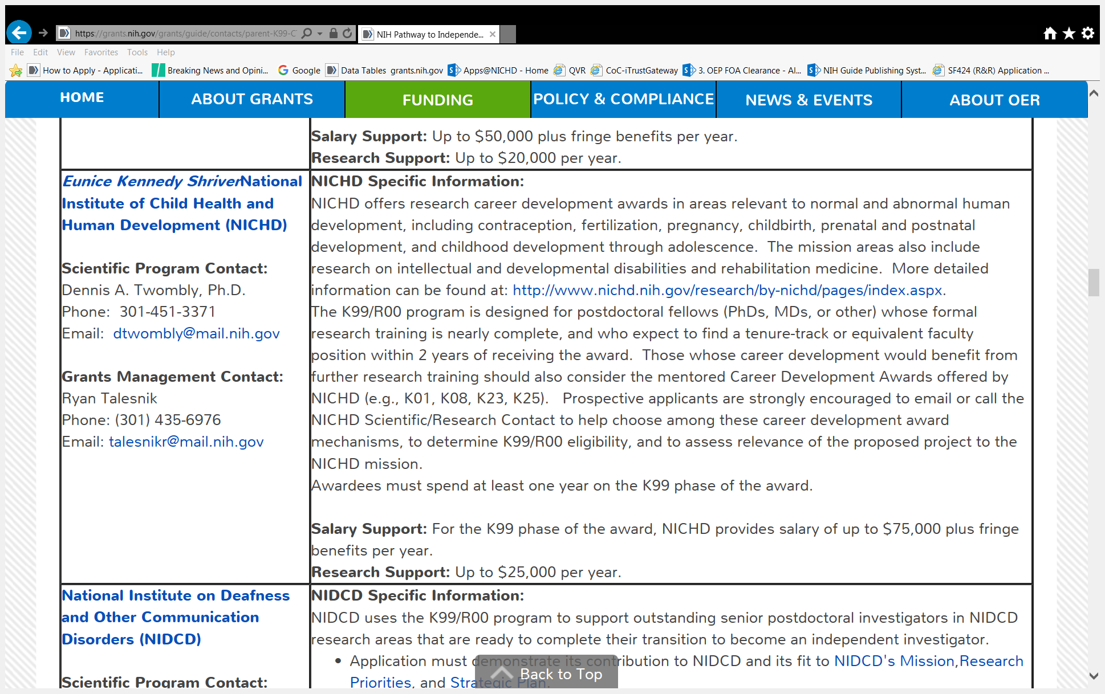
K99 Table of IC-specific Information
Notes:
Here is the IC Table entry for NICHD. Other IC requirements are on the same page above and below. This information is critical for eligibility as well as budgetary and other requirements.

Slide 8
Mentored Career Development (K) Awards
Purpose: Develop new research skills, release time for research and training activities in the biomedical, behavioral, or clinical sciences
Eligibility: Doctoral degree (PhD, MD, MD/PhD, DDS, DVM, etc.) US Citizens or permanent residents (except K99)
Typically junior faculty level applicants (except K99)
Current/prior PD/PI on K awards or major research project grants are ineligible for mentored K awards
Duration: 3 - 5 years (not renewable)
Commitment: Full-time appointment, minimum 75% effort
Support: Salary $75,000 - $100,000 + fringe (typical; IC dependent)
Research support: $25,000 to $50,000 (see IC Tables)
Notes:
Ineligible PI:
Similar, pending Career development award application
Current or former PD/PI on R01/Center PI/subproject leader or equivalent
Institution:
No foreign institutions
Foreign components allowable
Appointment:
Requires full-time appointment at application institution
Any minimum effort requirement must be covered by that appointment
Level of Effort:
Mentored awards require full-time effort (defined as at least 9 person months (i.e.75%) on research and the rest on other career development related activities); the balance of awardee time (up to 3 months -- 25%) can be devoted to additional research, teaching, clinical work, or other career development activities.
Note: some NIH Institutes permit 50% effort for clinical specialties—usually surgical subspecialties (e.g., NINDS, NCI, NIDDK, NHLBI)

Slide 9
Pathway to Independence Award (K99/R00)
Purpose: 2-phase award to help new researchers secure a tenure-track position and launch an independent research career.
Phase I: K99 Mentored Phase (1-2 years – tight window)
Supports late-stage postdoctoral research training
Provides salary + limited research expenses (varies, see IC Tables)
For Intramural fellows, DIR pays salary and expenses
Phase II: R00 Independent Phase (typically 3 years)
Requires tenure track or equivalent faculty position
Launch independent research program
$249,000 total costs per year (direct costs + full indirect costs)
Notes:
FAQ: What is the minimum time I must spend on the K99?
Most ICs require at least a full year on the K99 phase.
FAQ: Can I carry over unspent funds from the K99 phase to the R00 phase?
Most ICs will reduce the amount of the R00 award by the amount of any unobligated balances.

Slide 10
K99/R00 eligibility
Basic or clinical doctoral degree (ie, postdoctoral fellow or equivalent)
Domestic extramural or intramural institutions
US citizens or non-citizens
No more than 4 years postdoctoral research experience (-01 or –A1)
Exceptions for family / medical leave, military service, unemployment, clinical time
Cannot have held independent faculty-level position
Cannot have been independent Principal Investigator on:
Mentored Career Development Awards (eg, K01, K08, K23, K25)
Research project grants (eg, R01, R03, R21)
Other peer-reviewed NIH or non-NIH grants >$100,000 /yr direct costs
Project leaders on sub-projects of Program Project (P01) or Center (P50)
Notes:
FAQ: What if I am already supported by an F32 or T32?
The existing award will be terminated before awarding the K99. This can usually be done with no gap between awards.
Are there exceptions if my postdoc progress was interrupted by COVID?
Yes, per NOT-OD-20-158 and NOT-OD-21-106, applicants whose eligibility would have ended between June 2020 and Oct/Nov 2021 are entitled to a 2-cycle extension of eligibility.

Slide 11
Non-mentored K awards (Independent) K02, K05, K24
Not all NIH Institutes Participate: Refer to FOA !
Candidates must have active, independent peer-reviewed grant support at the time of award, usually from funding IC.
Awards support research career development or mentoring (K24)
Effort Requirements: IC-specific (check FOA)
NIH Salary Cap Applies
Renewable at some ICs only
Notes:
Required/allowable effort varies. Consult FOA for details

Slide 12
Institutional K Programs (K12, KL2)
Purpose: Awards to institutions to provide mentored research training for groups of clinical fellows and scientists to help them become independent research investigators.
Models: Nationwide programs versus local-institutional programs
Scholar eligibility: Final year of fellowship through early faculty
Commitment: Minimum 75% effort on the K12; usually 25% clinical effort
Duration of support: 2 - 5 years (6 - 8 yrs overall K support at some ICs)
Allowable costs: Varies with IC (see FOA)

Slide 13
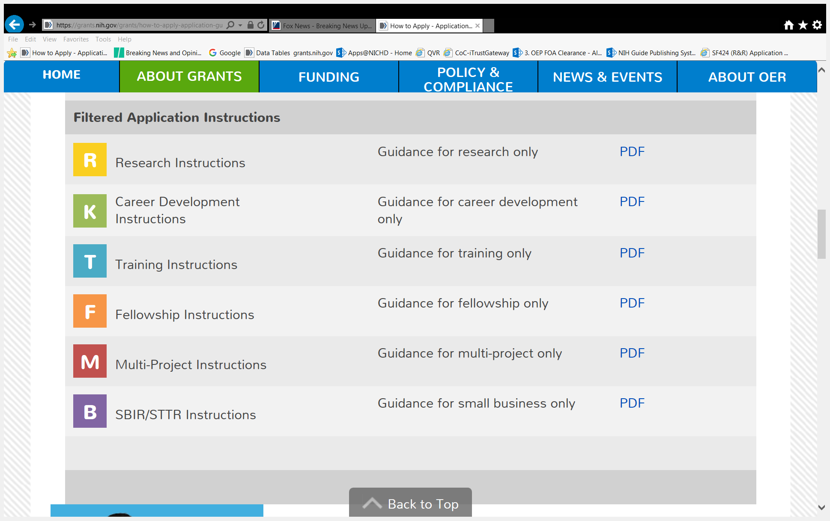
How to apply for a K award
Follow SF424 instructions
Individual K awards
Institutional K awards
Notes:
Application packet available via FOA link. These are SF424 instruction Guides.
FAQ: The FOA says to do one thing and the Application Guide says to do something else. Which do I follow?
Follow Application Guide instructions as default; follow FOA if it adds or replaces standard instructions

Slide 14
Clinical Trials Requirements
Identifying Whether NIH Considers Your Study to be a Clinical Trial is Crucial !
It impacts whether you need to:
Respond to a clinical trial-specific FOA
Address additional review criteria specific for clinical trials
Register and report your clinical trial in ClinicalTrials.gov
https://grants.nih.gov/policy/clinical-trials.htm
[Or Google “NIH Clinical Trials”]
Notes:
Most K programs have 3 versions of the FOAs: Independent Clinical Trials required, Independent Clinical Trials not Allowed, Basic Experimental Studies with Humans (BESH). Some FOAs are “Clinical Trials Optional”.

Slide 15
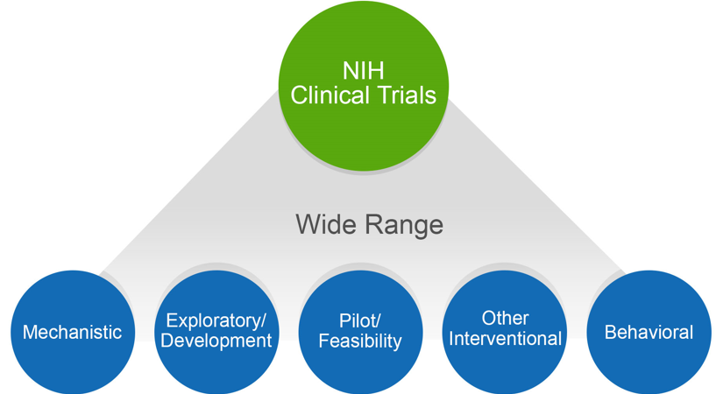
NIH Might Consider Your Human Subjects Research to be a “Clinical Trial”
https://grants.nih.gov/policy/clinical-trials.htm
[Or Google “NIH Clinical Trials”]
Does your study…
Involve one or more human subjects?
Prospectively assign human subject(s) to intervention(s)?
Evaluate the effect of intervention(s) on the human subject(s)?
Have a health-related biomedical or behavioral outcome?
If “yes” to ALL of these questions, your study is considered a clinical trial
Unsure how to answer the questions? We have a tool that can help! https://grants.nih.gov/ct-decision/
Notes:
NIH has a large number of case studies to help decide. Go to the listed link.

Slide 16
K Application Content
Candidate Section
Candidate’s Background
Career Goals and Objectives
Plan for Career Development Activities During Award Period
Research Plan
Research Strategy (Significance, Innovation, Approach) – Indicate research planned for K99 and R00 phases
Plans and Statements of Mentor, Co-Mentor(s) – 6 pages combined
Letters of Support from Collaborators, Contributors, Consultants – 6 pages combined
Environment & Institutional Commitment to the Candidate
Training in the Responsible Conduct of Research
Appendix (Warning: Very few materials are allowable!)
Reference Letters: for Mentored Ks -- Separate from Application
Notes:
See FOA for required sections. Follow instructions in the SF424 Application Guide.
Reference letters:
3 - 5 Letters submitted directly through the eRA Commons, not as part of the Grants.gov application. Candidates use Commons to monitor receipt only (can’t view actual reference letters)
Letters are due by application receipt date
Letters are matched with application at NIH and must include correct FOA number to allow a match.
Mentors and co-Mentors cannot submit reference letters
Budget -- Salary:
Based on Institutional Base Salary (IBS) for similar positions
Limits are the NIH-IC contribution, not an overall “salary cap”; institution can supplement with non-PHS funds
To calculate salary, pro-rate IBS to effort and then apply NIH-IC cap:
Scenario 1 (if IC cap $100K):
If IBS = $125,000
$125,000 x 75% = $93,750
NIH contribution = $93,750
Scenario 2 (if IC cap $100K):
If IBS = $155,000
$155,000 x 75% = $116,250
NIH contribution = $100,000

Slide 17
K Awards: SCIENTIFIC Review
Overall Impact Score (not a numerical average)
Scored Review Criteria (Scale 1-5)
Candidate
Career Development Plan
Research Plan (Rigor and reproducibility, SABV)
Mentor(s), Consultant(s), and Collaborator(s)
Environment and Institutional Commitment to the Candidate
Additional Review Criteria
Protection for Human Subjects
Inclusion of Women, Minorities, and Children
Vertebrate Animals
Biohazards
Resubmission, Renewal, Revision factors
Study Timeline (for Clinical Trials)
Additional Review Considerations
Training in the Responsible Conduct of Research
Select Agents Research
Resource Sharing Plans
Budget & Period of Support
Notes:
Consult the Funding Opportunity to find Review Criteria for any K type.
Some reviews are done at the Center for Scientific Review. Many are conducted by the IC Review Branch.
You can find rosters by looking up Peer Review committees on IC web sites.

Slide 18
Time Line: Application to Award
Receipt Dates: Feb/June/October 12 New K Applications
Review: 4-6 months later
Council: 3-4 months
Award: 1-2 months
Total time until award: 9-10 months
Total time for New + Resubmission:
12-18 months
Plan with your Mentor and Department Chair!
Notes:
These are typical time frames for most K or research project grant applications.
FAQ: How soon can I re-submit after the first application?
Your timeline should plan for 2 submissions, with one cycle in between. If you resubmit for the next available cycle, you will likely not yet have the summary statements with strengths and weaknesses. For an October first submission, for example, plan to resubmit the following July.

Slide 19
R01 Funding for New Investigators and Early Stage Investigators (ESI)
“New Investigator”: Applicant who has not previously competed successfully as PD/PI for a significant NIH independent research award (i.e., R01 grant)
“Early Stage Investigator”: A New Investigator who is within 10 years of the terminal doctoral degree or end of formal clinical training (residency and fellowship)
NIH funds R01s of ESIs at more favorable pay lines !!
Pay lines and relative advantage differ by NIH Institute; 3%-10% more generous pay lines
Advice for Early Stage Investigators
Apply for R01 now !!!!! (If you have preliminary data)
Notes:
ESI window can be extended for various situations (PI applies in eRA Commons)
Automatic 1-year extension for childbirth or adoption
Extension for purely clinical employment (not research)
NI is no longer used as funding criteria
For Further ESI eligibility questions, refer to ESI site.

Slide 20
You have a fundable score, now what?

Slide 21
Pre-Award Review
Just-in-Time (JIT):
Other Support (PI)
IRB/IACUC Approval(s)
Human Subjects Protection Education
PI Salary (Current salary and fringe if below the cap)
Institutional Commitment: Ensure “protected time”
Clinical Trials:
Milestones coordinated between PI and PO
Internal risk assessment determination (NICHD)
Notes:
FAQ: I just received a Just in Time (JIT) – does that mean by application will be funded?
No. eRA sends these out to applicants whose score is probably within as well as well beyond what the eventual pay line might be. Contact the PO for guidance on prospects for funding. Even then, they might not be able to give a firm answer because of a number of budgetary uncertainties.
Why is Other Support not required for mentors?
Other Support documentation is only required for key personnel who are committing measurable effort on a project.
What if the IRB/IACUC approval is still pending when JIT is requested?
Provide the current status and projected approval date(s). NIH will work with you to determine if issuing a restricted award for humans and/or animal subjects research pending receipt of the approval is appropriate. Restricted awards are typically limited to end of fiscal year actions.
What affect will the Clinical Trial Risk Assessment have on the project?
Depending on the determined risk level, quarterly or biannual reporting may be required.

Slide 22
Post Award Reporting
Research Performance Progress Report (RPPR)
Due 45 days prior to the next budget period start date (except K12, KL2)
Streamlined Non-Competing Award Process (SNAP) (except K12, KL2)
Publication List
Responsible Conduct of Research
Mentor Report(s)
Key Personnel (PI) Effort Changes
Mentor Changes
Other Support Changes
Large Unobligated Balance Justification
Notes:
What additional provisions are required on an institutional K awards?
The RPPR is due 60 days prior to the next budget period start date
Required to submit annual Federal Financial Reports
Required to submit prior approval to move funds (carryover) from previous budget period into current award

Slide 23
Post-Award Actions (No Prior Approval)
First No-Cost Extension up to 12 months (except K99s)
Rebudgeting (within scope)
Equipment Purchase (within scope)
Carryover (except Institutional K Awards)
Temporary Off-Site Training Experiences (< 3 months)
Leave of Absence (< 3 months)
Notes:
What award conditions must be maintained during a No-Cost Extension period?
PI must retain minimum effort level
New/updated Institutional Commitment extending protected time provisions
Continued mentor support and involvement
What are some examples of Change in Scope?
Change in specific aims
Change in human and/or animal subjects use
Shift in emphasis from one disease to another

Slide 24
Post-Award Actions (Prior Approval Required)
Change of Institution
Change of Mentor
Unpaid leave (up to 12 months)
Leave (> 3 months)
Temporary off-site training experiences (> 3 months)
Temporary effort reductions
Additional NCE requests and all K99 extension requests
Early scholar termination on Institutional K awards
Notes:
What additional information/documentation is required to transfers a mentored K award to a new institution?
Confirmation that the PI will receive the same support from the new institution and mentor(s) as at old institution
New qualified mentor statement(s), Institutional Commitment and Environment letters
What information should be included in a Leave of Absence prior approval?
Describe the impact of the leave on the project
Provide revised mentor plans with updated milestones
Provide a revised Institutional Commitment that extends protected time
For K99 awards, address the impact it will have on the R00 transition
What is required for a K99 NCE prior approval requests?
Prior approvals ensure that the PI’s transition to an independent position is on track. Therefore, these requests should provide plans for continued career development and the current status of job searches.
Some NIH Institutions/Centers (including NICHD) allow K99 extensions without funds so that the project does not enter closeout pending the R00 transition. In these cases, the K99 institution must confirm that sufficient institutional funds will be available to maintain minimum effort requirements. Check with the awarding IC to determine the allowability of such requests.

Slide 25
Temporary Effort Adjustments
PI may temporarily reduce their effort down to 50% for up to 12 continuous months during the project period
Allowed for personal/family situations such as parental leave, childcare, elder care, medical conditions, or a disability
Permission to temporarily reduce effort will not be approved to accommodate job opportunities, clinical practice, clinical training, or joint appointments
See NOT-OD-18-156 and NIHGPS Section 12.3.6.4
Notes:
Are there any limits on temporary effort adjustments?
PI must meet minimum effort requirements at the time of award
Only allowed on K award programs with a 75% minimum effort level requirement; not available for awards that require only 25-50% effort
Cannot request an effort reduction and reduction in appointment status (from full-time to part-time) simultaneously

Slide 26
K Award Salary Provisions
Salary Supplementation and Compensation on 3-5 Year Mentored K Award
See NOT-OD-17-094 and NIHGPS Section 12.8.1
Notes:
NOTE: Salary supplementation must not require extra duties or responsibilities that would interfere with the goals of the K award
NOTE: Salary compensation allowed as long the specific aims of the other supporting projects differ from those of the K award

Slide 27
Concurrent Support on Mentored K Award
Effort reduction in final two years of a 3 to 5-year individual mentored K award allowed when the PI successfully competes as a PI/PD on a Federal research award or grant of $100K direct costs from non-Federal sources
See NOT-OD-18-157 and NIHGPS Section 12.3.6.2
Notes:
Should any additional documentation be included in the research grant application?
A Department Chair letter should be included which addresses the PI’s continued focus on a research career, continued mentor access and reasserts protected time requirements.
Can the PI reduce their overall career development/research effort below 75% due to the research award?
NO. The effort required on the K award may be reduced to no less 50% at the recipient organization and replaced by effort and corresponding salary from the research award so that the total level of research commitment remains 75% or more for the duration of the mentored K award.

Slide 28
K99-R00: Transition to R00 Phase
No less than one year on K99 phase, no more than 2 years
Request transition at least 2 months prior to faculty offer/appointment (materials listed in FOA)
Administrative Review by NICHD Transition Committee
Considerations:
Type of faculty appointment (Tenure track or equivalent)
Academic environment (faculty, resources, students, reputation)
Progress on K99 research and career development objectives
Start-up package (space, equipment, supplies, staff, etc)
Minimum total research effort = 75% (institutional assurance)
Budget: $249,000 TC per year (negotiated with institution)
Consult with Program Staff!! (6 mo before and during transition)
Notes:
What happens to the K99 unobligated balance after the R00 is awarded?
The NIH Office of Financial Management automatically transfers the balance to the R00 account as part of the transition process
Each NIH Institute/Center determines whether this carryover may be utilized during the R00 phase
Institutes/Centers that do not allow use of this balance (including NICHD) will offset the balance on a subsequent R00 award
R00 application additional information
Type of Appointment: Provide the offer letter which includes 1) the position description, 2) confirmation that the position is not contingent on the PI receiving the R00
award and 3) guaranteed employment through the R00 phase
Academic Environment: Provide information on how the institution will foster the PI’s research career including 1) their ability to apply for and secure research project grant
support and 2) student mentoring opportunities
K99 Research Progress: Provide K99 progress information (submitted in lieu of a FRPPR) and the K99 mentor(s) final evaluation(s)
Start-Up Package: Must indicate that start-up funds will not be offset by the R00 award
Research Effort: Provide assurance that the PI will have protected time for research efforts as well as a proposed timeline for future research grant application submissions
Does the PI’s 75% research effort have to come solely from the R00 award?
NO. Only a portion of the effort requirement needs to be fulfilled by the R00 award.

Slide 29
Award Closeout
Final Reporting
FRPPR - Final Research Performance Progress Report (except K99, K22)
Federal Financial Report (FFR) (annual FFR required on Institution K)
Due within 120 days after the project period end date.
Grantees should ensure final expenditure report and final cash reports align
Project Outcomes should be written for lay public
Final Invention Statement (except Institutional K awards)

Slide 30
RESOURCES
NIH’s Research Career Development homepage (description of programs, FAQs, Policy Notices, NIH Resources)
https://researchtraining.nih.gov/programs/career-development
Applying Electronically:
http://grants.nih.gov/grants/how-to-apply-application-guide.htm
Career Development Chapter of NIH Grants Policy Statement: http://grants.nih.gov/grants/policy/nihgps/HTML5/section_12/12_research_career_development__k__awards.htm?Highlight=career development

Slide 31
RESOURCES
Current K Award Funding Mechanisms Available: https://researchtraining.nih.gov/programs/career-development
FAQs for all things K (also a mix of other training FAQs):
http://researchtraining.nih.gov/resources/faq
Career Path Resource:
https://researchtraining.nih.gov/career-path

Slide 32
Applicant: Sources of Guidance
NIH Program Announcements (PAs, RFAs)
Purpose, eligibility, allowable costs, review criteria
Tables of IC-specific Information, Requirements, & Staff Contacts
www.nih.gov (follow links to “training” or “peer review”)
Office of Extramural Research (“OER” grant programs, forms)
Center for Scientific Review: www.csr.nih.gov (review process)
Institute web sites: www.nichd.nih.gov (program interests)
Mentor (current and/or proposed)
Department Chair or Administrator
Institution’s Sponsored Programs Office
Other colleagues & faculty
Contact NIH Program Staff (before applying and after review) !!

Slide 33
Contacts
Dennis A. Twombly, Ph.D.
NICHD Training Officer
Email: dtwombly@mail.nih.gov
Ryan Talesnik
NICHD Senior Grants Management Specialist
Email: talesnikr@mail.nih.gov
For other Questions about this presentation, go to:
NICHD Booth
Ask a Training Officer Booth

