Slide 1
NIH Review Process (DRAFT)

Slide 2


Research Development Services provides a variety of services for faculty seeking support for research, creative work, public service and scholarly projects

Slide 3

Agenda
  How to find best study section/use PHS form
    NIH Assisted Referral Tool
    Don’t only use cover letter; make sure to use the ASSIST form
    Conflict of interest?
  Process
    Institution→NIH
    Post-submission materials
  Evaluating your summary statement
    Score
    Payline
  Using summary to resubmit successfully
  Early Career reviewer programHow to designat
Notes:
Introduce the fact that institutions have offices that shepherd external funding process.

Slide 4

Peer Review Process
National Institutes of Health
4
Center for Scientific Review
Assigns to IC & IRG / Study Section
Great Research Idea!
Study Section
Institution
Reviews for Scientific Merit
Submits Application
Institute
Evaluates for Relevance
Allocates Funds
Advisory Councils & Board
Investigator
Recommends Action
Performs the Research
Institute Director
Makes Funding Decision
Notes:
You may be in contact with these individuals, but more likely SPS and your DGA will manage these relationships

Slide 5
Peer Review Process
Center for Scientific Review (CSR) vs. Institute/Center Review:
CSR is most R01s, some PA/RFA
IC review is for specific program projects, training grants, career development awards, RFAs
Study Sections:
Do NOT make funding decisions
Evaluate and make recommendations based on review criteria
Provide priority scores (or not discussed) and written critiques (summary statements)
Reviewer assignments:
Minimum of 3 reviewers per proposal
Based on scientific content, expertise and consider COI
Notes:
You may be in contact with these individuals, but more likely SPS and your DGA will manage these relationships

Slide 6
Review Process
Top 50% of proposals are discussed in study section:
  9 hour day of review; each proposal gets ~13-14 minutes
In discussion:
  Reviewers with conflicts leave room
  Assigned reviewers present initial scores
  Primary reviewer explains project; strengths/weaknesses
  Other assigned reviewers follow
  Open discussion
  Assigned reviewers present score following discussion
    Indication of voting out of range
Notes:
Only 3 people in the room have read your whole proposal; other may have read your aims

Slide 7
Scoring Criteria
Review FOA: relevant criteria listed here
  Sent to reviewers; guides discussions; format for critiques in summary statement
Standard Criteria: 1-9
Significance
Approach
Innovation
Investigator(s)
Environment
Protection of human subjects/Vertebrate Animals/Biohazard*
Overall Impact/Priority Score: 1-9
Notes:
Other considerations- not factored into priority score: budget, resource sharing, foreign collaboration
All discussed application gets these priority scores; average of all final scores X 10; many Ics convert these scores into a percentile that becomes the base for “payline”

Slide 8
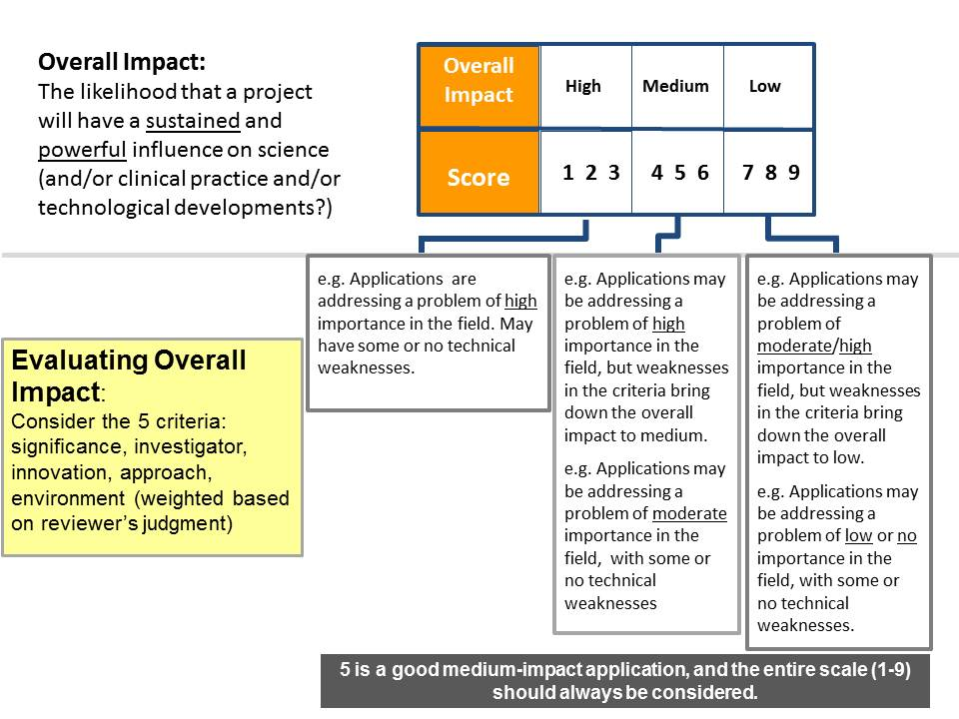
Priority/Impact Score
Notes:
Two questions drive reviewer determination about the likelihood that the proposed studies will have a strong and sustained impact on the scientific field
Should they do it?
Can they do it?
The overall impact is NOT mathematically related to individual criteria scores.

Slide 9
Summary Statement
PROGRAM CONTACT: Stuart Moss
(301) 435-6979 mossstua@mail.nih.gov
SUMMARY STATEMENT ( Privileged Communication )
Release Date: 03/27/2016
Application Number: 1 R21 HDXXXXX-01
Principal Investigator CURIE, MARIE, PHD
Applicant Organization: University of Paris
Review Group: CMIR Meeting Date: 03/23/2016
RFA/PA: PA11-261
Council: MAY 2014 PCC: RS -SM
Requested Start: 07/01/2016
Project Title: The Effect of Radium on the Testis
SRG Action: Impact/Priority Score: 30 Percentile: 22 #
Human Subjects: 10-No human subjects involved
Animal Subjects: 30-Vertebrate animals involved –no SRG concerns noted
Notes:
Priority score is posted in eRA commons 3 days after SRG meeting
Summary statement 4-8 week after SRG meeting

Slide 10
Summary Statement
RESUME AND SUMMARY OF DISCUSSION:
Written by the SRO based on the final outcome of the discussion, summarizes strengths & weaknesses mentioned by all reviewers, highlights areas of concurrence & disagreement between reviewers.
CRITIQUE 1
Significance: 3
Investigator: 1
Innovation: 1
Approach: 4
Environment: 1
Overall Impact:
Written by the individual reviewer to summarize their opinion on the overall strengths and weaknesses of the application.
Notes:
Description is provided by applicant
Summary of discussion provided
Reviewer critiques are largely uneditied
Committee recommendations (budget, human subjects, etc.)

Slide 11
Early Career Reviewer Program
Help emerging researchers advance their careers by exposing them to experience in peer review that may make them more competitive as applicants
Train and educate qualified scientists without prior CSR review experience to develop critical and well-trained reviewers
Enrich the existing pool of reviewers by including scientists from less research-intensive institutions
Notes:
Have at least 2 years experience as a full-time faculty member or researcher in a similar role. Post-doctoral fellows are not eligible.
Show evidence of an active, independent research program. Examples include publications, presentations, institutional research support, patents, acting as supervisor of student projects.
Have at least 2 recent senior-authored research publications in peer-reviewed journals in the last 2 years. In press publications are considered and author position can be as single author, corresponding author, or first or last author.

Slide 12
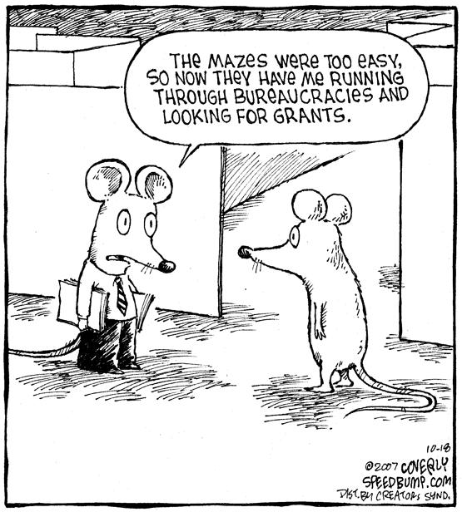
Work with RDS
Contact us for supporting the development of your proposals.
Research Development Services
www.rds.uoregon.edu
rds@uoregon.edu
Kate Petcosky-Kulkarni
kpetcos2@uoregon.edu
541-346-6239
Notes:
Have at least 2 years experience as a full-time faculty member or researcher in a similar role. Post-doctoral fellows are not eligible.
Show evidence of an active, independent research program. Examples include publications, presentations, institutional research support, patents, acting as supervisor of student projects.
Have at least 2 recent senior-authored research publications in peer-reviewed journals in the last 2 years. In press publications are considered and author position can be as single author, corresponding author, or first or last author.

